Slide 1



Accelerating Growth Through eCommerce
Workshop Add-Ons
Instructor-led
Onsite or Remote
~7 hours
Overview:
Meeting the evolving expectations of today’s retail customer can be challenging. Many companies can benefit from delivering a more customer-centric purchasing experience — from legacy brands to direct-to-consumer challengers.
Business Outcomes:
Boost online and in-store sales.
Improve time-to-market for new products.
Get ahead of digital-first competitor brands.
DAY 1 eCommerce
Delve into the ecosystem of eCommerce models and retail customer insights. Choose the strategies that best serve your acquisition, conversion, and retention goals. Develop a clear understanding of a successful eCommerce experience for your brand.

Slide 2
High-Level Agenda
Time | Section
0:00–1:15 | The eCommerce Ecosystem
1:15–2:45 | The eCommerce Formula: Traffic
2:45–4:30 | The eCommerce Formula: Conversion and Average Order Value
4:30–5:30 | The eCommerce Formula: Retention and Churn
1.5 hours | Lunch, breaks
1 hour | Opening/closing

Slide 3

Pre-Class Materials and Preparation
Printing
eCommerce Models Worksheet (one per person, letter-sized, color)
eCommerce Poster (one copy, poster-sized, single-sided, color)
Other Materials
Standard program materials.
Make sure to have dot stickers in two different colors.
Students should have access to their phone/laptop for activities.
Preparation
Refer to documentation in this program’s speaker notes for guidance on how to customize it for clients.
Look out for yellow “LXA note” stickies throughout the deck,
which indicate areas that can be easily customized for client deliveries.
LXA note
xxx

Slide 4
Accelerating Growth Through eCommerce

Slide 5



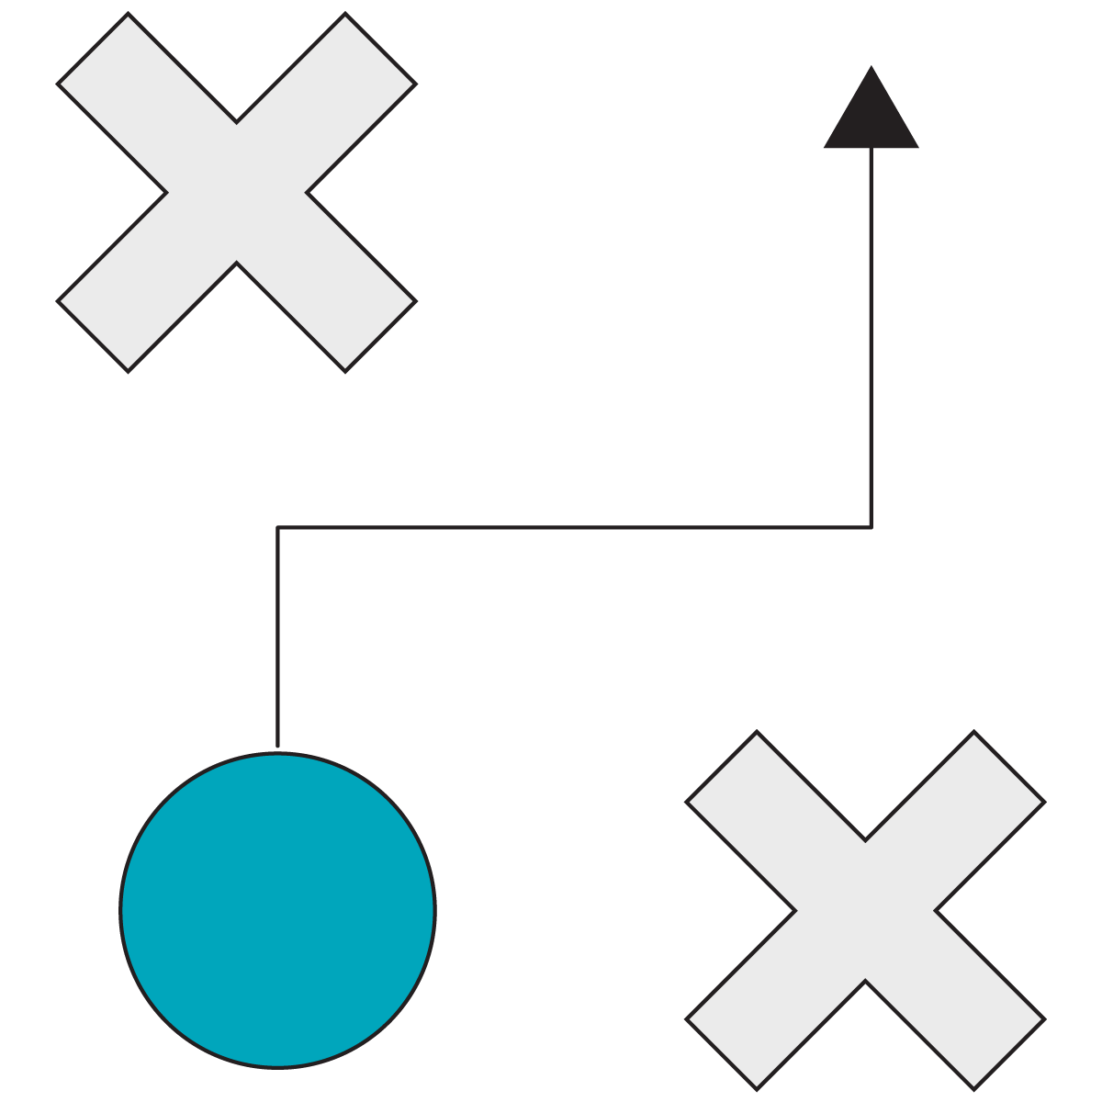


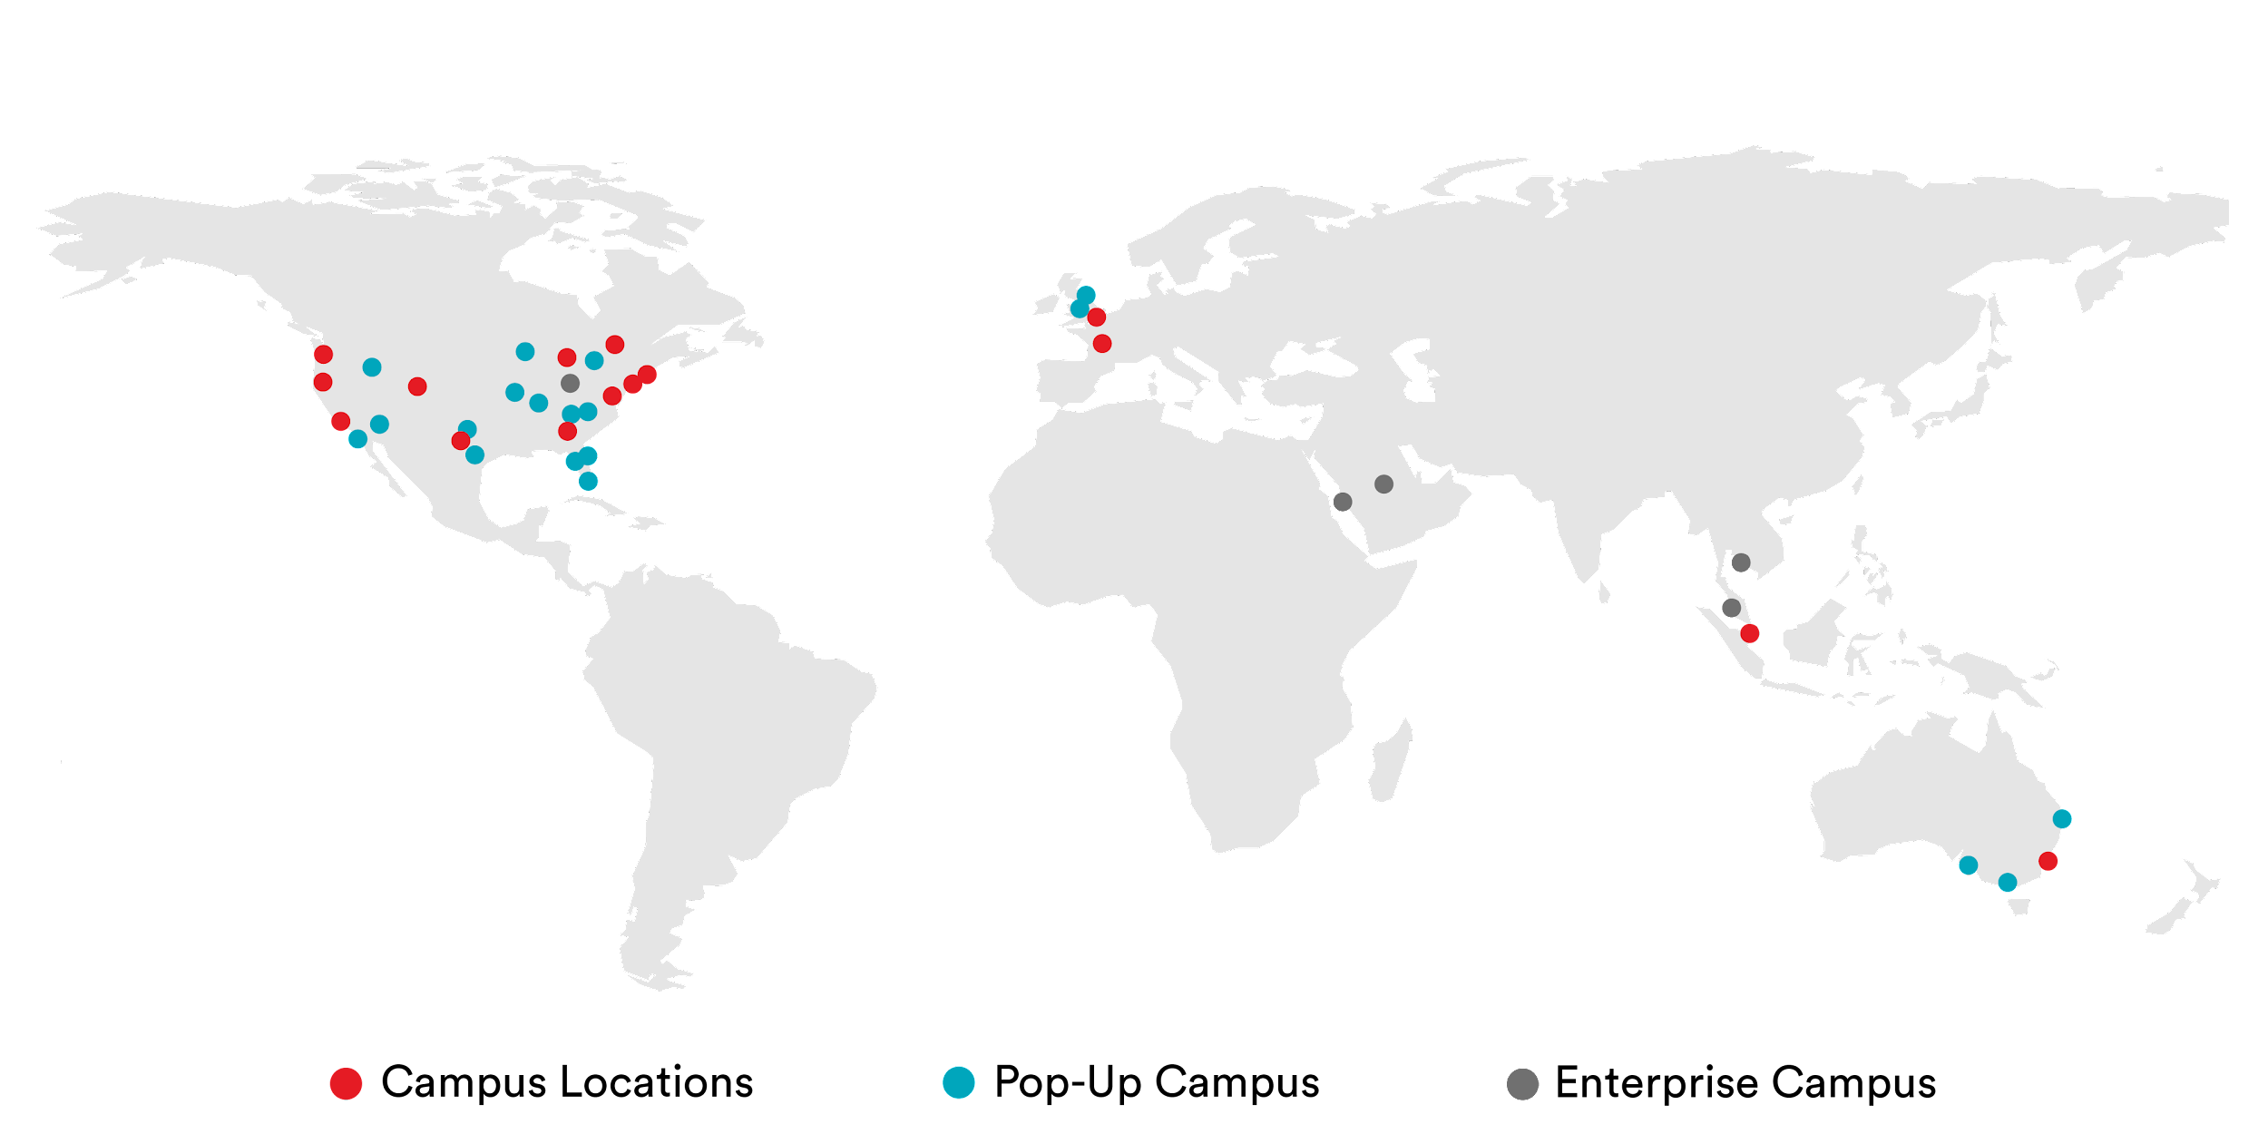
Who we are and what we do?
General Assembly
Accelerate Digital Transformation Through Enabling Talent
Digital Fluency
Engineering & Technology
General Assembly is a global upskilling and reskilling company with unmatched scale. Our programs enable teams to grow, compete, and thrive in the digital economy.
Marketing
Product Management
Data & AI
UX & Visual Design
400 clients including 35 Fortune 100 companies.
50,000 employees trained in 80 cities.
1,500 instructors and 20,000 in-network experts.
78,000 course alumni across 33 campuses.
10,000 live online learners in 5 years of remote delivery.
Fast Facts
General Assembly is a brand of the Adecco Group, the world's foremost provider of staffing, career transition, and talent development solutions.
Notes:
You all have heard about GA before and that we are part of the Adecco Group, but let me tell you a little more about who we actually are.
We are your colleagues, a global team of individuals who are extremely passionate about helping other individuals achieve their career aspirations,
and in particular, teach those individuals the most in-demand digital and tech skills.
We work with many Fortune 500 clients, powering their upskilling and reskilling academies to enable people grow, compete, and be successful in the digital world.
The key areas that we help enable are Digital Fluency (and Digital Foundations programme forms part of this capability), but also more function or role-specific training like Marketing, Technology, Data, Product and UX. And we help people achieve their learning goals offering learning journeys that target their specific growth needs.. Some fast facts about us:
We have helped over 400 clients including 35 Fortune 100 companies.
We have trained over 50,000 employees in 80 cities around the globe.
Our instructor network is made up of 1,500 instructors and 20,000 in-network experts.
78,000 course alumni across 33 campuses.
10,000 online learners in 5 years of remote delivery.

Slide 6
The eCommerce Ecosystem
Accelerating Growth Through eCommerce
The eCommerce Ecosystem
The eCommerce Formula: Traffic
The eCommerce Formula: Conversion and AOV
The eCommerce Formula: Retention and Churn
Notes:
Duration: 75 minutes

Slide 7

Where We’re Going
Describe the pros and cons of each eCommerce model (DTC, eRetail, and Amazon).
Identify the metrics that contribute to the success of any eCommerce business model.
Notes:
Purpose: Share the expressed learning goals with students.
For Remote deliveries:
Capture a screenshot of this slide and drop it in the class Slack channel.

Slide 8
Shop Around
10 minutes
What was the last thing you bought online?
Describe your most recent online purchase. (It can be any product from any online source.)
Share your reflections on the experience:
Why did you purchase it online?
What worked about the experience? What didn’t?
Did the experience meet your expectations? Why or why not?
Notes:
Purpose: Get participants to think about eCommerce from their own experience as consumers and begin to empathize with consumers’ experiences.
TEACHING TIPS:
At ~5 minutes through the lesson, give a reminder for each partner to share.
At the end of the exercise, invite a few volunteers to share their purchase experience.
For Remote deliveries:
Screenshot this slide and drop it in the Slack channel.
At the 60-second mark, send a message to all rooms: “Start to wrap up your discussions. Rooms will close in one minute!”

Slide 9
Today’s Customer Wants…
Efficiency
Ease of Use
Utility
Savings
VIP Access
Notes:
Purpose: Distinguish what drives customers to make decisions and purchases.
TALKING POINTS:
When customers engage in an eCommerce experience, they expect efficiency, ease of use, and utility.
They want savings and VIP access to further enhance the experience.

Slide 10

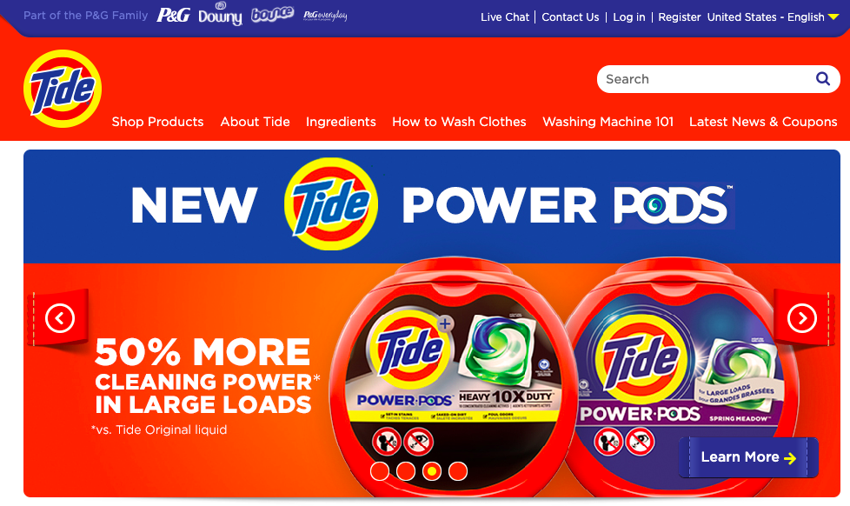
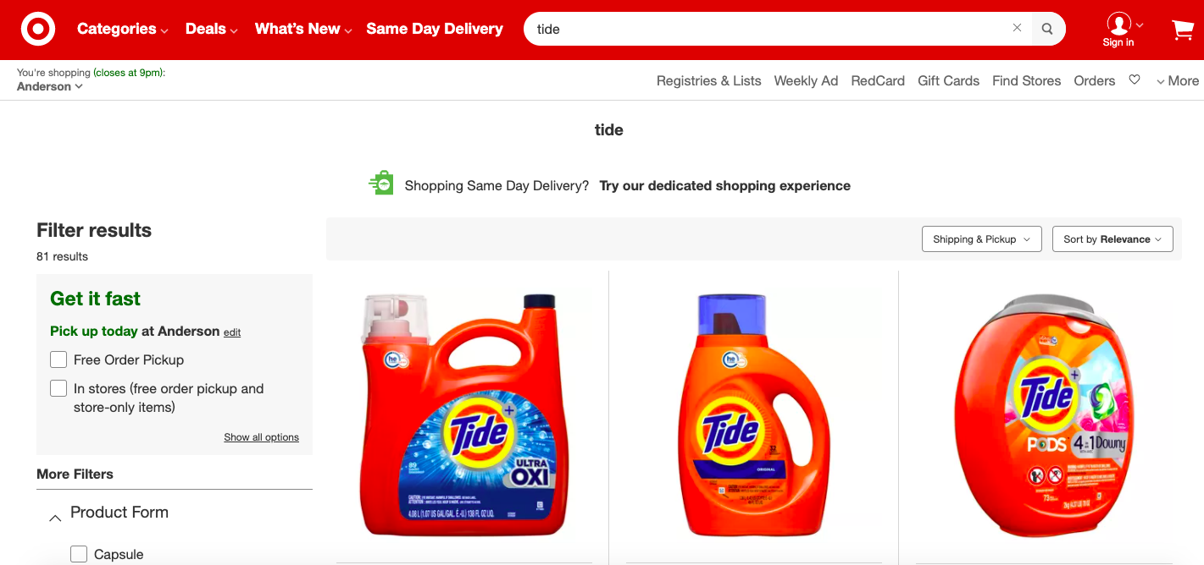
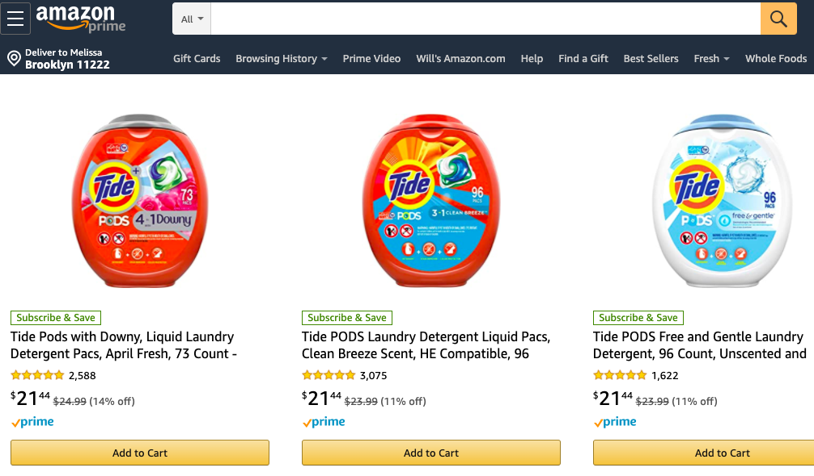
How to Do eCommerce
LXA note
Swap out images to represent clients’ products.
Direct to Consumer (DTC)
eRetail
Amazon
Notes:
Purpose: Lay out the three major models for how eCommerce can be done.
TALKING POINTS:
When thinking about eCommerce today, there are three basic models:
Direct to consumer, or DTC: A brand sells products directly on its website (e.g., tide.com) and a customer can purchase via that website.
eRetail: A brand partners with a big-box retailer such as Target, Walmart, Macy’s, etc., to sell products through its eCommerce store. Customers purchase at target.com.
Amazon: The big name in eCommerce.

Slide 11
Thinking Critically About the Models
Benefits to Consumers
Benefits to Brands
Marketing Concerns
What about this model fulfills a consumer need or want?
How does this model support our goals?
Are there marketing concerns that might prevent your brand from being able to take advantage of this model?
Notes:
Purpose: Provide a framework for how to think about each eCommerce model.
TALKING POINTS:
One way of looking at eCommerce models is to ground your thinking in consumer benefits and potential opportunities.
You also need to weigh your concerns as marketers during this evaluation.
Ultimately, you need to find your comfort zone.

Slide 12
Direct to Consumer (DTC)
Benefits to Consumers
Benefits to Brands
Marketing Concerns
I get access to all of the brand’s products in one place.
I get rewarded for my spending.
It’s like being in the store when I get to pick samples!
I get all the data.
I get all the margins.
I have direct ability to guide, manage, and impact every step of consumer relationship and journey.
Cost to develop and deploy.
Cost of ongoing maintenance.
AOV too low to justify shipping charges.
Supply chain issues.
Consumer ratings trust: “Is the brand curating reviews?”
Notes:
Purpose: Provide a framework for how to think about each eCommerce model.
TALKING POINTS:
One way of looking at eCommerce models is to ground your thinking in consumer benefits and potential opportunities.
You also need to weigh your concerns as marketers during this evaluation.
Ultimately, you need to find your comfort zone.

Slide 13
DTC Journey
LXA note
Swap out example with one more relevant to client.
Nadja sees a Facebook ad for Nike sneakers that goes directly to nike.com.
This pair will work and has good reviews.
Straight from ad to relevant products.
Love that it’s just one brand and the filters actually work.
Oh, but I know I can trust Nike.
Are these reviews trustworthy...
Hmmmm, is this the best price?
I like this pair! Shoot, they’re out of stock...
I know Amazon doesn’t curate reviews...
Amazon and eBay are more price-competitive, but are they trustworthy?
This wouldn’t happen on Amazon...
Notes:
Purpose: Consider the DTC model through the journey of a customer.
TALKING POINTS:
First touch: Facebook to Nike.
Narrative:
“Oh wow, I love that they’re so conscious about giving me options. And the filters actually work! There are customer reviews.”
They have so many wide shoes in stock and those are so hard to find, that’s awesome.” “I like these ones on sale!” “They’re out of stock? That never happens on Amazon…”
“That’s kind of annoying. OK, I’ll try another pair. Oh! These are cute for work, I’ll add them to my cart.”
“I wonder if I can get them somewhere cheaper, though… Oh, here they are! Eek, eBay? I don’t know if they’re legit. What if they’re fake?”
“I can always trust Nike.”
TEACHING TIPS:
Click to build in each step of the journey.

Slide 14
DTC Journey (Cont.)
LXA note
Swap out example with one more relevant to client.
Nadja sees a Facebook ad for Nike sneakers that goes directly to nike.com.
At least it comes in three days.
Oh wow, their customer service is so helpful!
Worth it, can’t get these anywhere else!
Ugh, now I have to sign up or fill out all my info.
They responded immediately — I feel like I don’t get that most places...
I have to PAY for shipping? What?!?
I love the shoe’s quality, but it just doesn’t fit right.
This wouldn’t happen at Macy’s....
I’m buying an expensive pair of shoes, shouldn’t this be included?
Notes:
Purpose: Consider the DTC model through the journey of a customer.
TALKING POINTS:
Narrative:
Filling in all my shipping and billing info takes forever. Macy’s already has that info.”
“But I guess it’s worth it!”
“I hate paying for shipping! But at least it’s fast.”
“The shoes are here! But they don’t quite fit perfectly…”
“That return was SO easy.”
TEACHING TIPS:
Click to build in each step of the journey.

Slide 15
eRetail
Benefits to Consumers
Benefits to Brands
Marketing Concerns
I can use my card and use any rewards I earn toward other stuff.
I can buy online and pick up in-store or see something in-store and buy it online later.
I don’t have to buy from one brand; I get a mix of products.
Access to audience without any of the difficulty in driving that traffic.
Shoppers are primed to convert.
Can be a predictable and reliable sales channel relative to DTC.
Overall, less control.
How do we make our brand feel like our brand in an eRetailer’s branded environment?
Difficult to surface our brands in eRetailer’s emails and promotions.
Access to data.
Sales attribution.
Notes:
Purpose: Provide a framework for how to think about each eCommerce model.
TALKING POINTS:
One way of looking at eCommerce models is to ground your thinking in consumer benefits and potential opportunities.
You also need to weigh your concerns as marketers during this evaluation.
Ultimately, you need to find your comfort zone.

Slide 16
eRetail Journey
LXA note
Swap out example with one more relevant to client.
Nadja needs a pair of sneakers by tomorrow but doesn’t have time to shop in-store.
They’re doing BOGO 50%! I’ll get the blue ones, too.
Macy’s has to have sneakers that will work.
I’ll get two pairs of each and pick up in-store.
Oh great, the Nike logo. I like their shoes.
Macy’s always has great discounts.
At least I can return in-store.
There are so many brands that all look the same.
Pick up in-store. Whew! Crisis averted.
Ugh, there are no reviews. I’ll Google it.
I need this to be quick and painless.
Amazon always has reviews...
Notes:
Purpose: Consider the eRetail model through the journey of a customer.
TALKING POINTS:
First touch: Customer navigates directly to retailer’s site.
Narrative:
“I need shoes ASAP. Macy’s always has options.”
“But, sometimes there are just TOO many options.”
“I see something I like. That will speed things up!”
“And a promotion! My lucky day.”
“I want reviews to see what other people actually think about the shoes and how they fit.”
“I couldn’t find any reviews, so I’ll just get two sizes and return one.”
“Pick up in-store! Convenient, don’t have to wait for shipping.”
TEACHING TIPS:
Click to build in each step of the journey.

Slide 17
Amazon
Benefits to Consumers
Benefits to Brands
Marketing Concerns
I have a one-stop shop for all of my product needs.
My payment and shipping info are saved.
It’s easy to compare prices.
I can see loads of reviews to determine what’s best for me.
Wide audience.
Consumers can discover your product within the site.
One-stop shop for advertising and selling.
Subscription models may be available to increase loyalty.
Overall, less control.
Lots of competition within the site.
Limited access to data and targeting.
Price competition.
Sales attribution.
Notes:
Purpose: Provide a framework for how to think about each eCommerce model.
TALKING POINTS:
One way of looking at eCommerce models is to ground your thinking in consumer benefits and potential opportunities.
You also need to weigh your concerns as marketers during this evaluation.
Ultimately, you need to find your comfort zone.

Slide 18
Amazon Journey
LXA note
Swap out example with one more relevant to client.
Nadja is shopping for a coat on Amazon and sees an ad for Nike sneakers.
These are only $5 more and 2-day shipping!
Those shoes look cute!
Oh, that’s super cheap for Nike!
I’m going to look up these shoes on Amazon.
Prime is so convenient.
What is Shoes4u? This description is weird.
Amazon knows me really well.
One click to buy. Done!
I wonder if these are fake...
Amazon lets anybody sell anything...
Seriously, Prime is SO convenient.
Notes:
Purpose: Consider the Amazon model through the journey of a customer.
TALKING POINTS:
First touch: Ad on Amazon.
Narrative:
“Those shoes are great! And what a great price!”
“But who’s selling them? It doesn’t seem like it’s Nike or even Amazon...”
“I’m suspicious of this listing. Let me search on Amazon to see what other options they might have.”
“Not a bad price, and with Prime everything is so convenient!”
TEACHING TIPS:
Click to build in each step of the journey.

Slide 19
Debate and Defend
In this exercise, students will work in small groups (4–5 people) to think through each eCommerce model that was just reviewed and how the model could (or couldn’t) be applied for their brand. Students can use the eCommerce Model Worksheet for the exercise.
Students should use what they learned about each model, as well as what they know about their business, to determine:
How they could improve on that model, if it’s currently in use.
If that model could/should be used by their brand and, if so, why they should start using it.
The goal is to get students to understand that not every eCommerce model is right for every brand and consider how their specific brand/products are better suited for certain models.
Give groups 10 minutes to brainstorm together. Then, lead a debrief conversation by walking through each model and having volunteers share the pros/cons of that model for their brand. Make note of what students say on a whiteboard.

Slide 20


Debate and Defend
10 minutes
eCommerce Models Worksheet
With your group, think through and note how each eCommerce model might be applied to your brand.
Are we using this model already?
If we are using it:
How is it going? How could it be improved?
If we’re not using it:
Should we start? Why or why not?
Be prepared to share your insights with the class!
Notes:
Purpose: Have students apply what they learned about each eCommerce model to their own brand.
TEACHING TIPS:
Remind students to note their responses. They’ll be asked to share out with the class in the debrief.
To debrief, create a space on the whiteboard for each model.
Invite volunteers to share what their group discussed about each model and record the answers on the board.
Reference: worksheet.
For Remote deliveries:
Screenshot this slide and drop it in the Slack channel.
At the 60-second mark, send a message to all rooms: “Start to wrap up your discussions. Rooms will close in one minute!”
Add a Slack message with each of the three eCommerce models (each model in a separate message).
Have students thread their responses about each model and use responses to start the debrief.

Slide 21
Some Things Don’t Change
Like the eCommerce formula for revenue:
Traffic
Conversion Rate
Average Order Value
Revenue
x
x
=
Notes:
Purpose: Dissect the eCommerce formula.
TALKING POINTS:
For any eCommerce model, the basic elements of success don’t change.
To get to revenue in eCommerce, traffic, conversions, and average order value are critical.

Slide 22
Some Things Don’t Change (Cont.)
The Formula for Profit:
Average Order Value
Traffic
Conversion Rate
Revenue
x
x
=
–
Costs
Notes:
Purpose: Dissect the eCommerce formula.
TALKING POINTS:
For any eCommerce model, the basic elements of success don’t change.
To get to revenue in eCommerce, traffic, conversions, and average order value are critical.

Slide 23
Some Things Don’t Change (Cont.)
…the formula for business results:
Profit
Churn Rate
Retention Rate
Customer Lifetime Value
x
x
=
Notes:
Purpose: Dissect the eCommerce formula.
TALKING POINTS:
And finally, for real business results, we want to get to customer lifetime value.
We can multiply profit by churn rate (i.e., how often we lose customers) and retention rate (i.e., how long we keep customers) to get to lifetime value.
Really calculating out lifetime value is a complicated process that is very specific to any business model. We don’t have time to get to it today.
Customer lifetime value versus customer acquisition cost is the fundamental premise of an eCommerce business.

Slide 24
The eCommerce Formulas
In this exercise, students will reflect on how their eCommerce business is going today (if it’s going at all). Make sure that the eCommerce Poster is displayed in the room and that students have dots in two different colors to use.
Based on the walk-throughs of the eCommerce formulas and their reflection on the different models from the previous exercise, students should use the dots to indicate the parts of the eCommerce formula in which they are strongest or weakest. They can use dot stickers to “vote” on the different elements of eCommerce. The goal is to help students focus on where they can improve or build on existing successes. It will also help the instructors understand which parts of the program to spend more or less time on.
Give students 5–10 minutes to dot vote. Then, lead a debrief discussion as a full class. Have the group stand near the posters and observe where clusters of dots appeared. Identify some major clusters and lead a discussion on what is working or not in that area. Ask students who voted on that area to explain why they voted and what is or isn’t working.

Slide 25
The eCommerce Formulas
10 minutes
eCommerce Poster
Let’s reflect on the key elements of the eCommerce formulas.
In which are we strongest? Add a green dot to those elements.
In which are we weakest? Add a red dot to those elements.
Traffic
Conversion Rate
Average Order Value
Churn Rate
Retention Rate
Notes:
Purpose: Have students reflect on the parts of the formula in which they have the most room to grow.
TALKING POINTS:
We are going to focus on these elements of the eCommerce formulas in today’s class.
To get started, let’s reflect on which of these we are doing well with and which we can improve.
TEACHING TIPS:
For the debrief, observe where green and red dots are clustering.
Ask participants why those areas are strong/weak today.
Reference: poster.
For Remote deliveries:
Have students use the Zoom annotate function to indicate which elements are working well and which aren’t:
Star: Strongest.
X: Weakest.

Slide 26

Let’s Recap
Each eCommerce model offers unique benefits and challenges for brands and consumers.
Choose which model to use based on your product offerings, price points, and audience.
Focusing on elements in the eCommerce formula can help you optimize your experience.
Notes:
Purpose: Wrap up the section and reinforce takeaways.
TEACHING TIPS:
Check for understanding and see if students have additional questions on the material covered.

Slide 27
The eCommerce Formula: Traffic
Accelerating Growth Through eCommerce
The eCommerce Ecosystem
The eCommerce Formula: Traffic
The eCommerce Formula: Conversion and AOV
The eCommerce Formula: Retention and Churn
Notes:
Duration: 90 minutes

Slide 28
Where We’re Going
Describe the role that search and social media marketing play in the eCommerce ecosystem.
Combine paid social, paid search, and organic search tactics to drive traffic to your eCommerce experience.
Notes:
Purpose: Share the expressed learning goals with students.
For Remote deliveries:
Capture a screenshot of this slide and drop it in the class Slack channel.

Slide 29
Driving eCommerce Traffic
Paid Social
Search Marketing
Notes:
Purpose: Introduce the two channels for this section.
TALKING POINTS:
When we think about driving traffic to an eCommerce platform, whether it’s DTC or eRetail, paid social and search engine marketing are the key players.
TEACHING TIPS:
Note that Amazon is its own ecosystem and ways of driving traffic.

Slide 30
Why These Two?
In the long run, many channels and tactics will drive traffic to your eCommerce experience.
Starting out, paid social and search marketing will serve as the foundation of traffic and acquisition strategies.
Other channels will build on learnings and techniques from these.
Consumers have grown accustomed to search and social as part and parcel of their shopping experiences and behavior.
Notes:
Purpose: Explain why paid social and search are so critical to eCommerce.
TALKING POINTS:
Why did we pick these two channels? These are a few of the reasons they are so critical to eCommerce success.
TEACHING TIPS:
Note that we aren’t going to do a deep dive into either of these channels or get super technical.
Rather, we want to level-set on key terms and understand how these channels can serve to drive eCommerce traffic.

Slide 31
Paid Social
The eCommerce Formula: Traffic
Notes:
Purpose: Introduce paid social.
TALKING POINTS:
We’ll start with an overview of paid social.

Slide 32
Is Organic Social Dead?
Allow us to put it simply: Yes.
Organic reach is statistically 0% on Facebook and continually decreasing on Instagram.
No amount of posts to your brand page will change that.
Influencers can achieve some organic reach, but they generally cap out at 5% organic reach.
Notes:
Purpose: Explain why we’re focusing on paid instead of organic social.
TALKING POINTS:
Organic social is basically dead. It’s all happening in paid social these days.
Organic social simply doesn’t have reach, especially not the reach you need to be driving traffic to an eCommerce site.

Slide 33



For eCommerce, It’s All About the Targeting
Specific segments
Broad segments
Notes:
Purpose: Tie paid social tactics back to eCommerce traffic.
TALKING POINTS:
Paid social is all about reaching the right audiences.
For the audiences we are trying to create, we need to be specific.
We will be leveraging that specificity to create more relevant ads and target people who are more likely to use our products.
Typically, larger companies only focus on audience segments of millions of individuals. For effective and targeted paid social media campaigns, we want to create audiences of between 10,000 and 250,000 individuals.
If we have first-party customer email lists, those will be critical for using Lookalike and Custom Audiences on Facebook, Instagram, and others.

Slide 34
For Example…
LXA note
Swap out example with one more relevant to client.
Attic people
Patio people
Porch people
Lanai people
If this works, then we’ll move on to…
Dock people
Shed people
Notes:
Purpose: Demonstrate the importance of testing and refining audience segments.
TALKING POINTS:
If we have a hunch that patio people are a good audience segment and it works, we can then segment further into the home furniture segments.

Slide 35
For Example...
LXA note
Swap out example with one more relevant to client.
Too Broad
Too Specific
Just Right
Camping
Boating
100,000
100,000
Adventure
300,000
Fishing
Moms 21–34 years old
600,000
100,000
Nightclubs
Tomorrowland
100,000
Festivals
300,000
100,000
DJs
100,000
Notes:
Purpose: Visually demonstrate how segments can be too broad or too specific and show how to strike the right balance.
TALKING POINTS:
If we just look at moms ages 21–34, we have 600,000 people in our potential audience pool.
But if we get too specific, we’re too targeted and there aren’t enough people to reach for our message.
Striking the right balance (in this case, people interested in adventure or festivals) gives us a good audience size for our campaign.

Slide 36

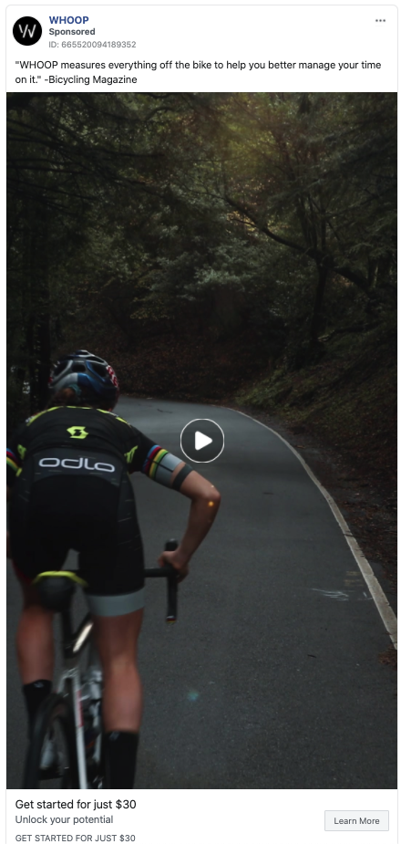
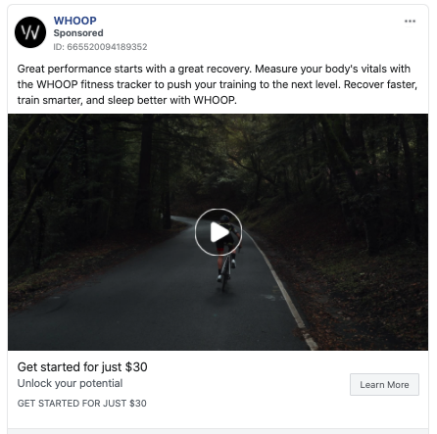
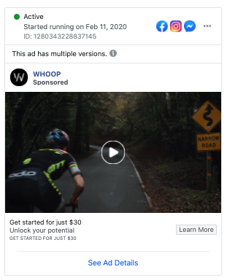
Segmentation on Facebook
LXA note
Swap out example with one more relevant to client.
Source: Facebook Ad Library
Notes:
Purpose: Explore how paid social can be tailored to specific audiences for maximum impact.
TALKING POINTS:
Here are three variations on the same creative for fitness tracker, Whoop, with the same offer.
The segment revolves around road cycling with sub-segments within that.
These audience segments revolve around marital status, preferences, education level, device and platform, and much more, as opposed to just demographics.
The audience segment for the campaign is 100–150K people within a specific age range, road cycling interests, who are married and of a certain education level, gender, and other demographics.

Slide 37
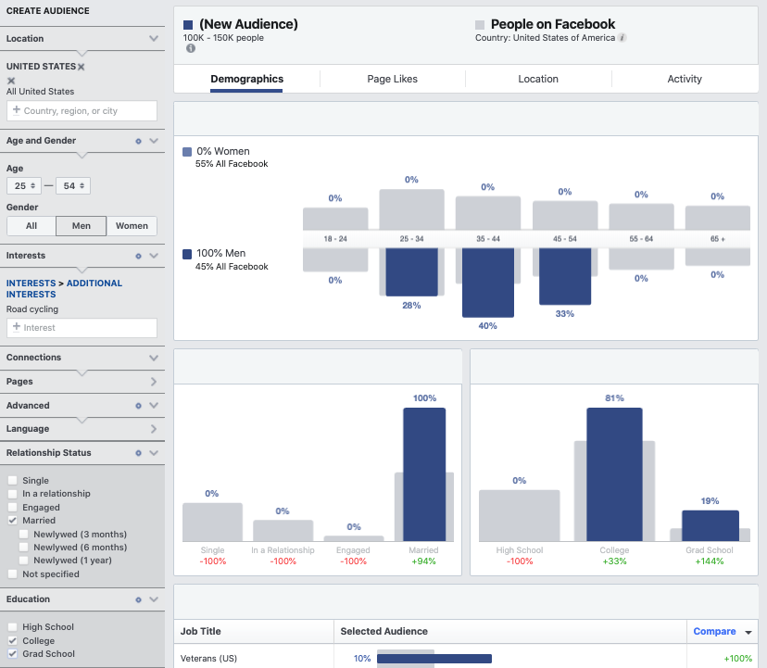
Segmentation on Facebook (Cont.)
LXA note
Swap out example with one more relevant to client.
Source: Facebook Audience Insights
Notes:
Purpose: Explore how paid social can be tailored to specific audiences for maximum impact.
TALKING POINTS:
Here is a Facebook Audience Insight segment that reflects targeting for the ads we just looked at, based on how men interested in road cycling tend to index.
These audience segments revolve around marital status, preferences, education level, device and platform, and much more, as opposed to just demographics.
The audience segment for the campaign is 100–150K people within a specific age range, road cycling interests, who are married and of a certain education level, gender, and other demographics.

Slide 38
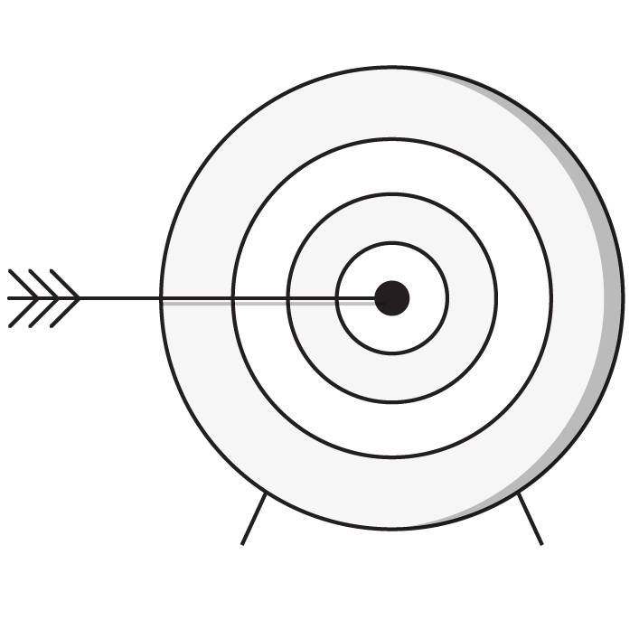
Success in Social for eCommerce
Customer acquisition cost (CAC) is lower than average order value.
Test on smaller audiences with lower budgets.
Iterate creative and campaigns frequently.
Utilize advanced targeting to drive consumer value.
Drive down cost per click (CPC) and CAC over time.
Notes:
Purpose: Share best practices for effective paid social for eCommerce.
TALKING POINTS:
Here are some best practices and tips to keep in mind when using paid social campaigns to drive eCommerce traffic.
For metrics such as CAC, CPC, and others, you can usually find benchmarks from the social platform depending on the type of client and business.

Slide 39
Search Marketing
The eCommerce Formula: Traffic
Notes:
Purpose: Introduce paid social.
TALKING POINTS:
Next, we’ll dive into search.

Slide 40
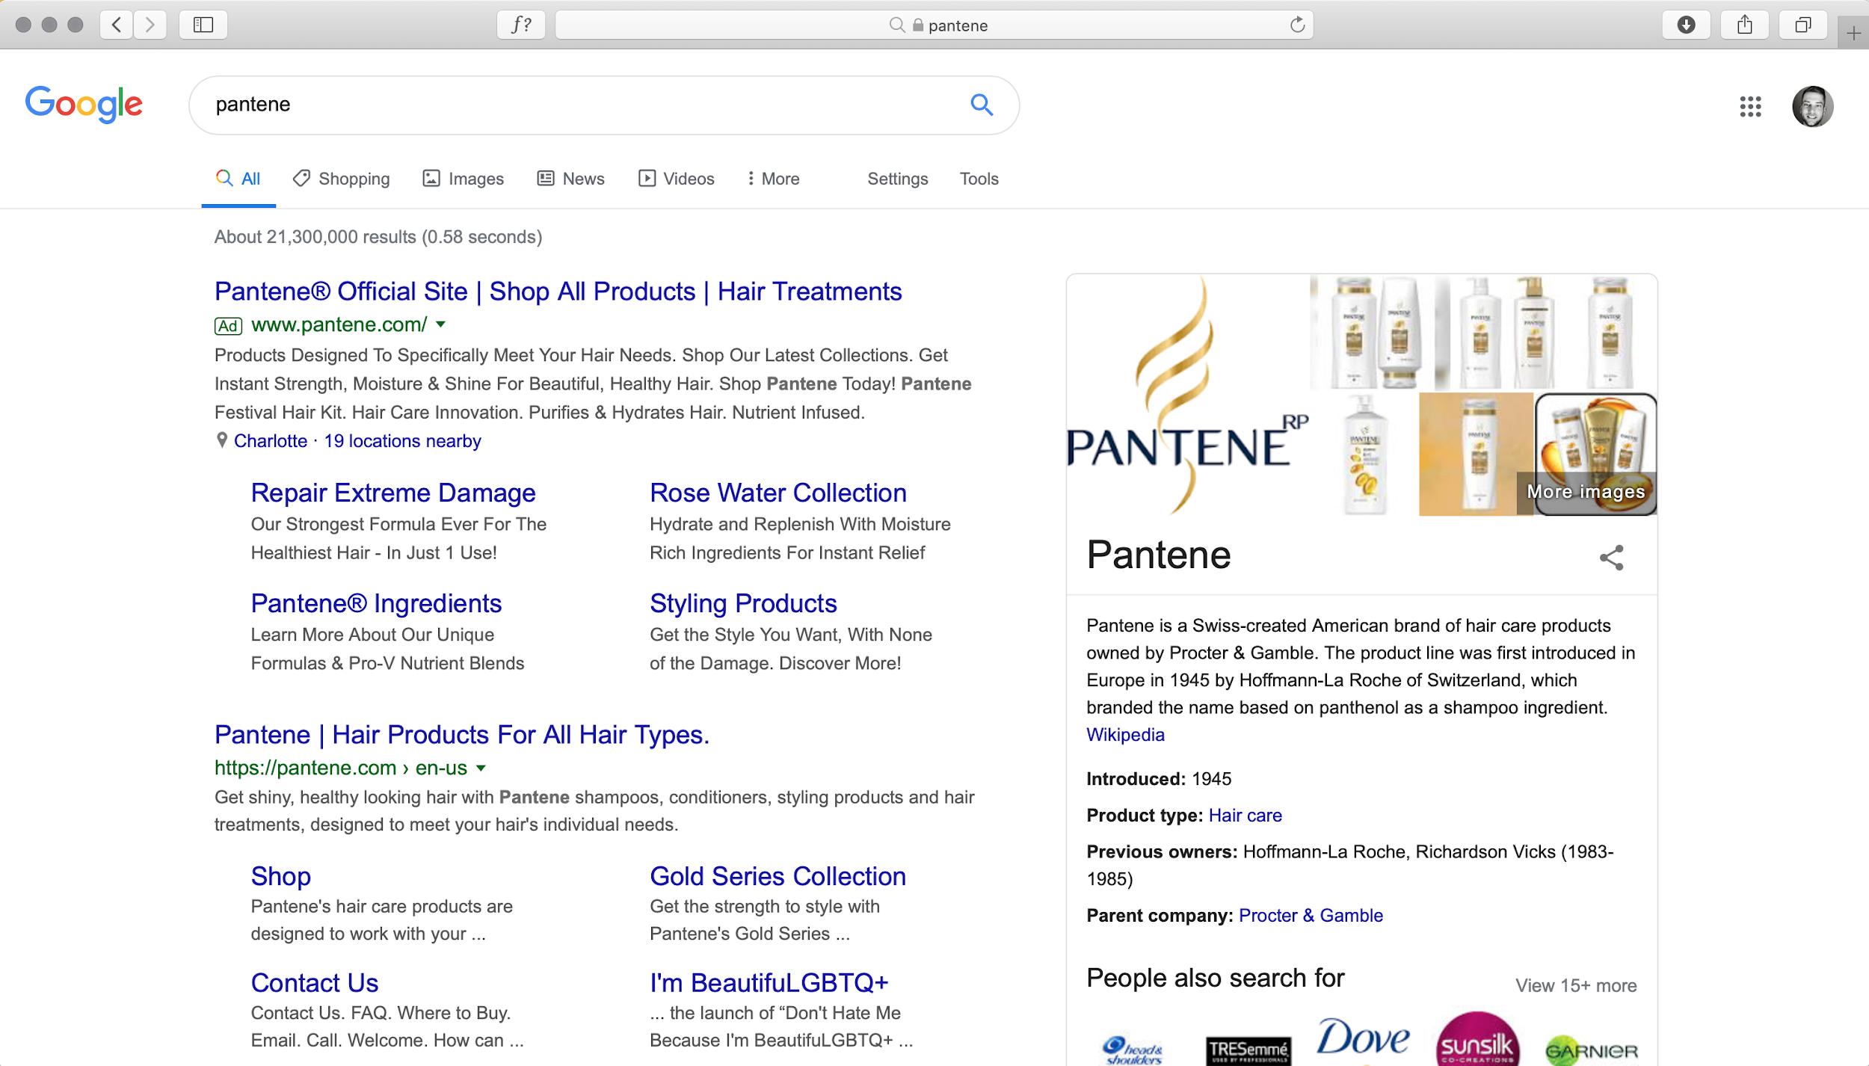
Paid vs. Organic Search
Paid
Organic
Notes:
Purpose: Show the clear difference between paid and organic results.
TEACHING TIPS:
Show the audience the difference between SEM and SEO, or paid and organic.
Consider a live demo here: Google a certain product or brand name and look at the paid and organic results.

Slide 41
But If I Have Great SEO, Why Do I Need to Pay?
Your goal is to own the search engine results page (SERP).
Win the battle of competitors versus your brand.
Increase links to your site.
Increase the likelihood that someone will click on your page.
Guaranteed visibility, regardless of algorithm changes.
Notes:
Purpose: Explain why both SEO and PPC are necessary in eCommerce.
TALKING POINTS:
Paid and organic search together help you own the search engine results page (SERP).
Everyone knows that scrolling to the bottom half of results (much less beyond Page 1) rarely happens.
Paid and organic together increase the likelihood of clicks to your site, even if competitors come in or search algorithm processes change.

Slide 42



Why People Search
Navigational Users are looking to access a specific web destination; important to have plenty of branded content.
Transactional Users are intending to make a purchase.
Informational Users are looking for information or the answer to a question.
Notes:
Purpose: Identify the different types of search intent.
TALKING POINTS:
Let’s look at search from the customer perspective for a moment.
When people search, there are generally three things they’re looking for. These three categories are known as “intent.”
Navigational: Not just directions but looking to get to a specific webpage.
Informational: Need an answer to a question.
Transactional: Searching in order to buy something.
You might think that transactional is the only type of search that’s really relevant for eCommerce, but informational and navigational are also important for driving traffic.
Can anyone explain why?

Slide 43



Why Keyword Research?
Understand the consumer mindset.
Improve your content.
Prioritize what you have.
Notes:
Purpose: Discuss keyword research and why it is important.
TALKING POINTS:
Keyword research is not a mystery; it’s very powerful for influencing current and future content.
It’s a great source of data to help you understand you consumer, improve your content, and prioritize content.
Understand the consumer mindset: Discover what people are actually searching for and understand consumer behavior online.
Improve your content: Set a new standard for content quality and direct your content creation efforts based on what people are looking for.
Prioritize and predict: Prioritize opportunities based on relevance, intent, volume, competition, and trends. Predict the future.

Slide 44




Types of Keywords
Brand
Non-Brand
Short-Tail
Long-Tail
Notes:
Purpose: Introduce how to categorize types of keywords.
TEACHING TIPS:
Rather than explaining each term, ask students to define brand versus non-brand keywords and short-tail versus long-tail keywords.

Slide 45
Keyword Research Lite
What are our brand versus non-brand and short-tail versus long-tail keywords?
Brand
Non-Brand
Short-Tail
Long-Tail
Notes:
Purpose: Get students to apply the types of keywords framework to their own business.
TEACHING TIPS:
Have a few students shout out answers for each category. Record their answers on a whiteboard or flipchart.
For Remote deliveries:
Screenshot this slide and drop it in the Slack channel. Have students thread their answers.
Alternatively, have students add their answers in the Zoom chat.
Alternatively, have students use Zoom Annotate to write out their answers in a text box next to the appropriate puzzle piece.

Slide 46

Keyword Strategy
Low conversion rate
Low intent
Generic problem keywords
Generic product keywords
Brand product keywords
Brand keywords
High conversion rate
High intent
Notes:
Purpose: Correlate keyword intent and conversion rate.
TALKING POINTS:
Branded keywords generally have higher conversion rates and higher intent, or higher likelihood that the person is looking for something specific to your brand and will take some type of action.
These are the branded keywords we just introduced.
They’re also probably the transactional or navigational search types we looked at before.
Generic keywords, or non-brand keywords, generally have lower conversion rates and lower intent.
These are probably informational searches.
Product keywords are in the middle: They’re not branded but still indicate some intent and more likely conversion.
These are usually informational or possibly navigational searches.

Slide 47
Keyword Strategy
LXA note
Swap out example with one more relevant to client.
Low Intent
Medium Intent
High Intent
“Summer Grilling”
“Indoor Gardening”
“Ocean Pollution”
“Weber Grill vs. Broil King”
“How Do AeroGarden Kits Work”
“Best Charity for Ocean Pollution”
“How Much is the Weber Grill at Home Depot?”
“Where to Buy AeroGarden”
“Donate to Save the Waves”
High volume
Low volume
Low conversion rate
High conversion rate
Notes:
Purpose: Map concepts of intent and conversion rate to actual keywords.
TALKING POINTS:
Lower-intent, lower-conversion rate keywords are generally non-branded, informational, and higher in volume.
As we move to the right, to higher intent and conversion rate, we see branded terms come into play.
How do transactional and navigational searches come into play with high-intent keywords?

Slide 48
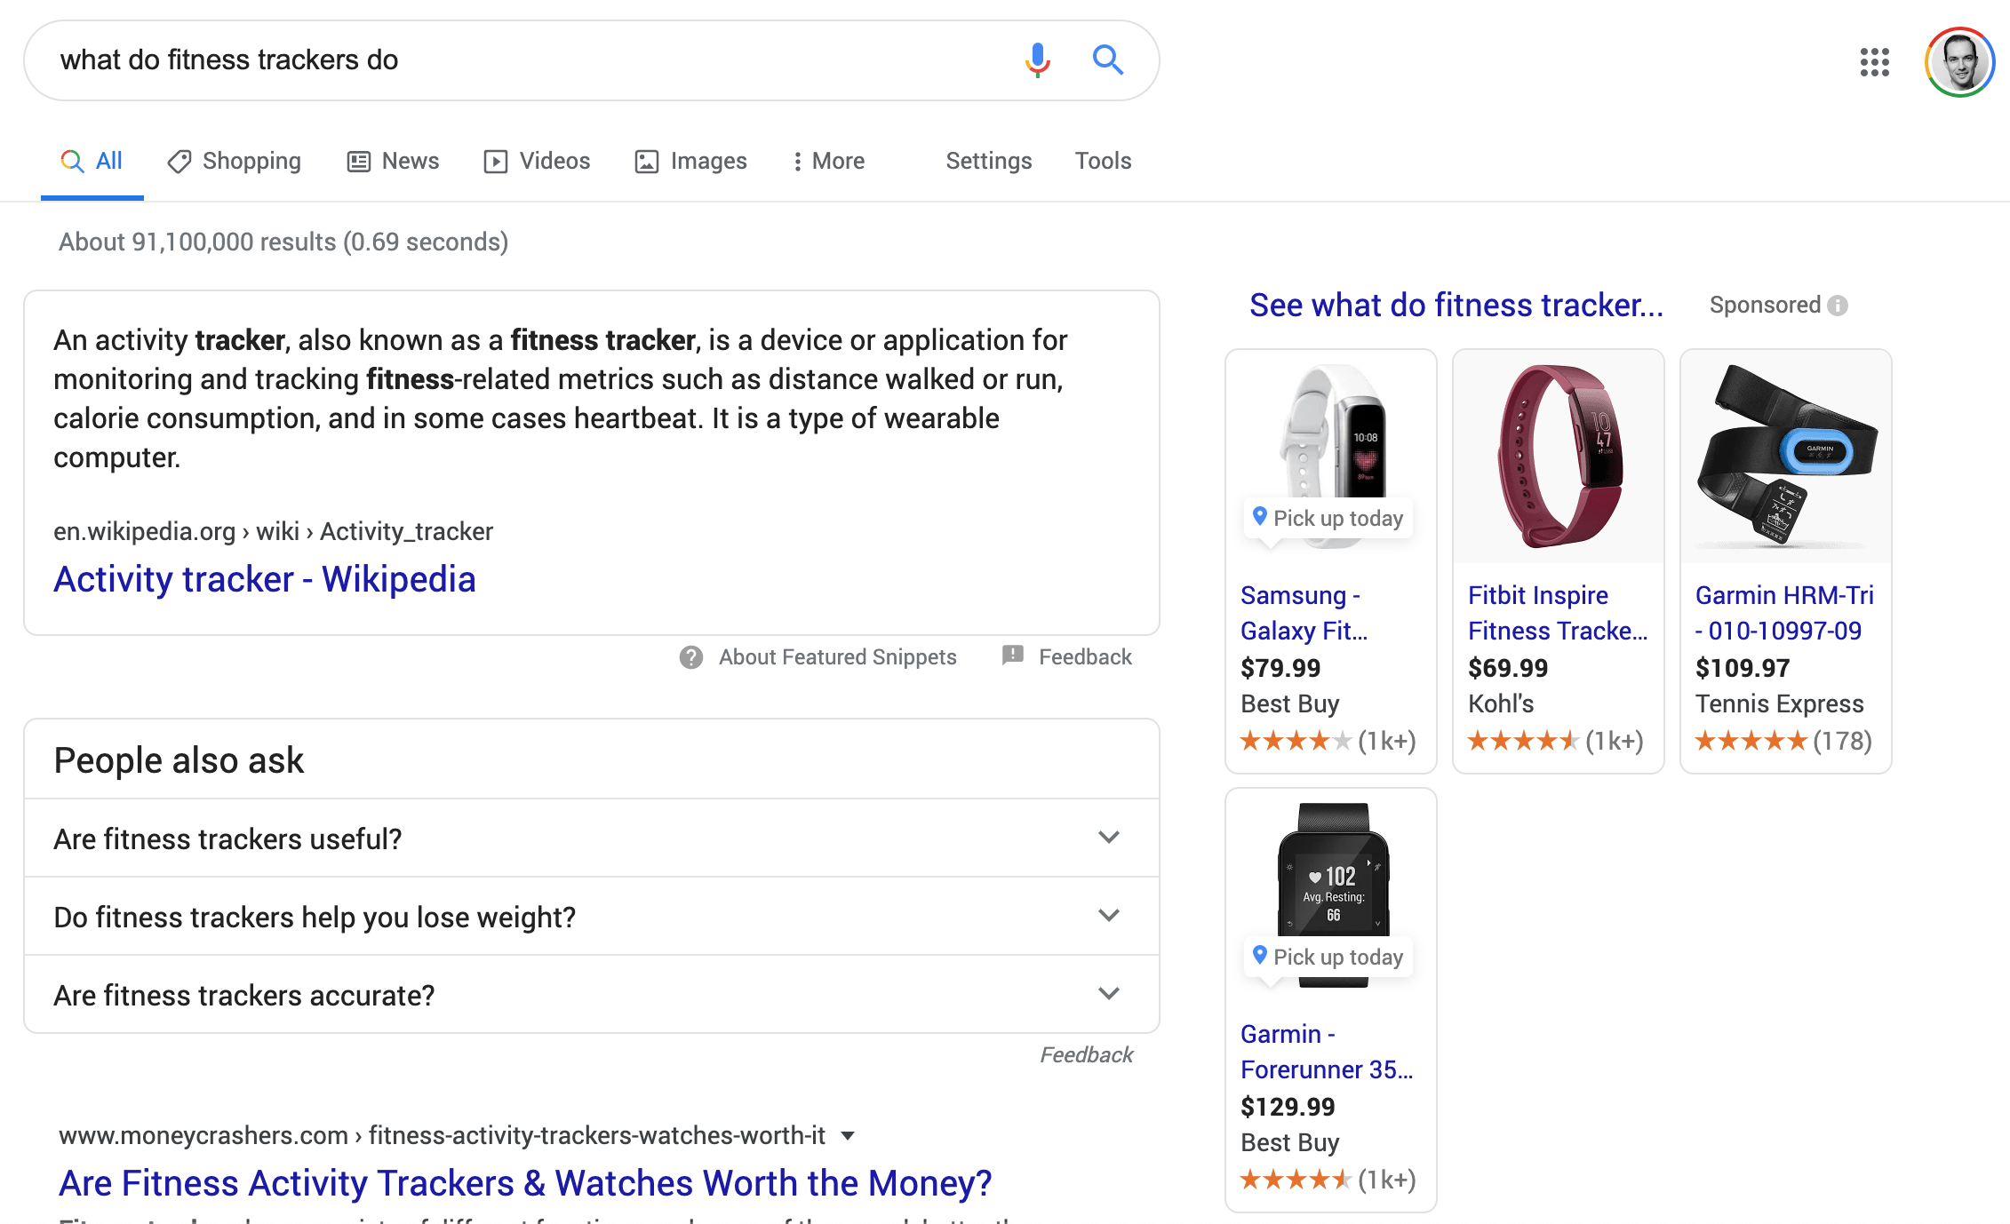
A Journey Through Search
LXA note
Swap out example with one more relevant to client. This builds over five slides.
Search journeys often begin with research.
Paid search is less emphasized on SERPs.
SEO is the strategic advantage.
Notes:
Purpose: Walk through a case study of searching for fitness trackers, focused on two competitive brands (Whoop and Oura).
TALKING POINTS:
We’re going to walk through an example of two competitors in the fitness tracker space and how they’re using search to beat each other out.
As we’re walking through the example, ask yourself: Who is winning the battle of owning the SERP?
The two brands are Whoop (we saw some examples of their paid Facebook campaigns earlier) and its competitor, Oura.
We start with research.
What type of search is this? How high is the intent?

Slide 49
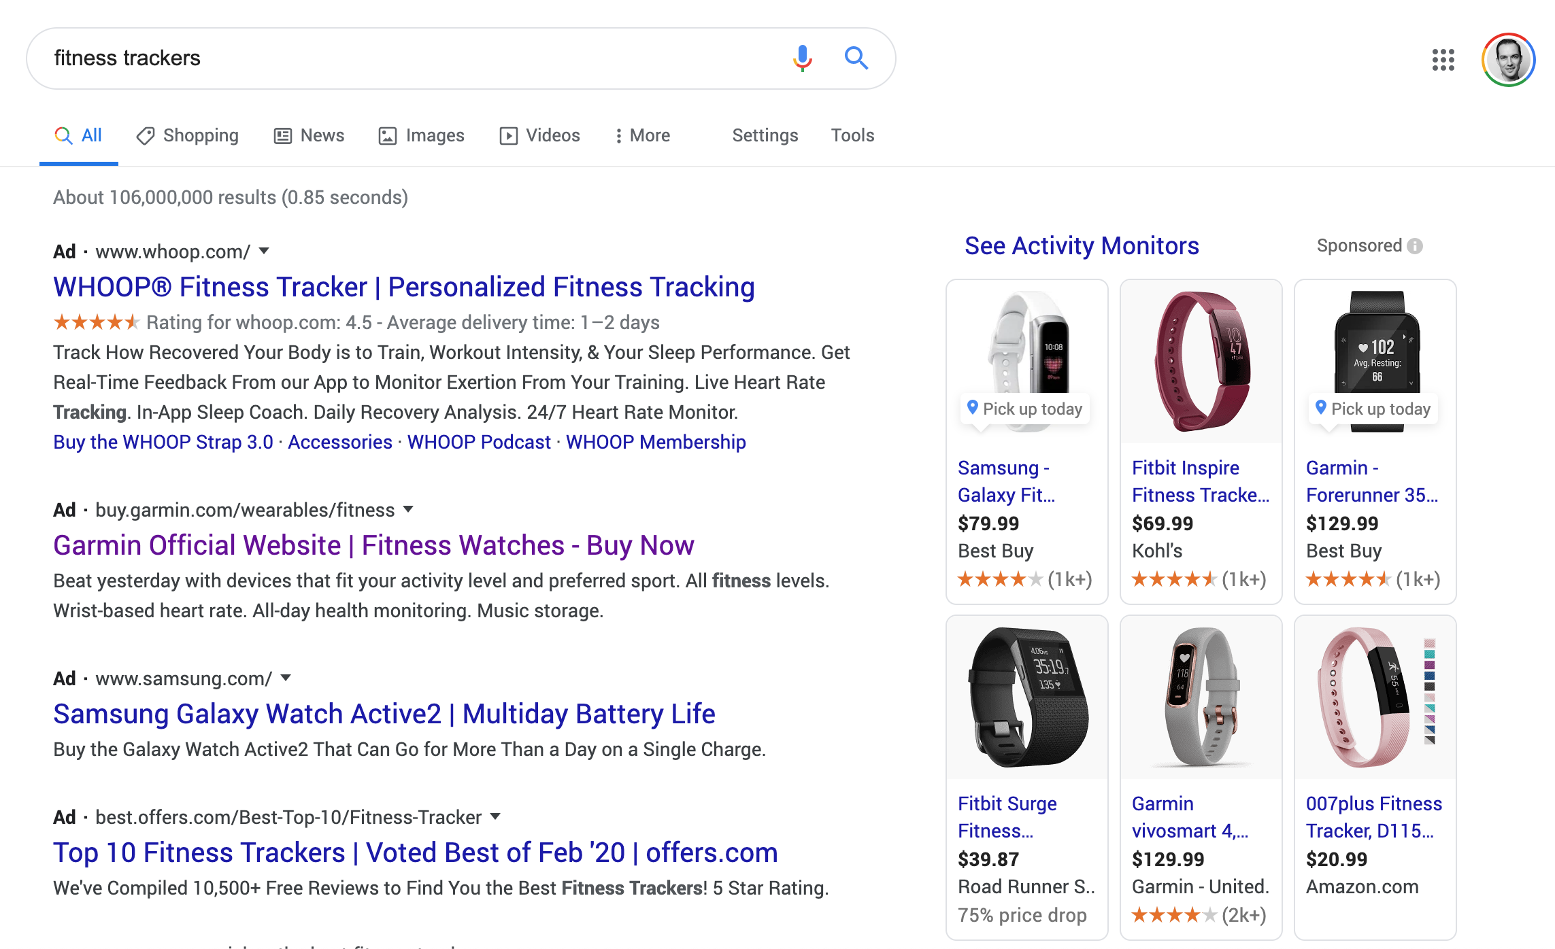
A Journey Through Search (Cont.)
Gradually, research shifts from information to products.
Paid search becomes more competitive and prominent.
Notes:
Purpose: Walk through a case study of searching for fitness trackers, focused on two competitive brands (Whoop and Oura).
TALKING POINTS:
Our research shifts from general research to more product research.
What type of search is this now? Has intent changed?

Slide 50
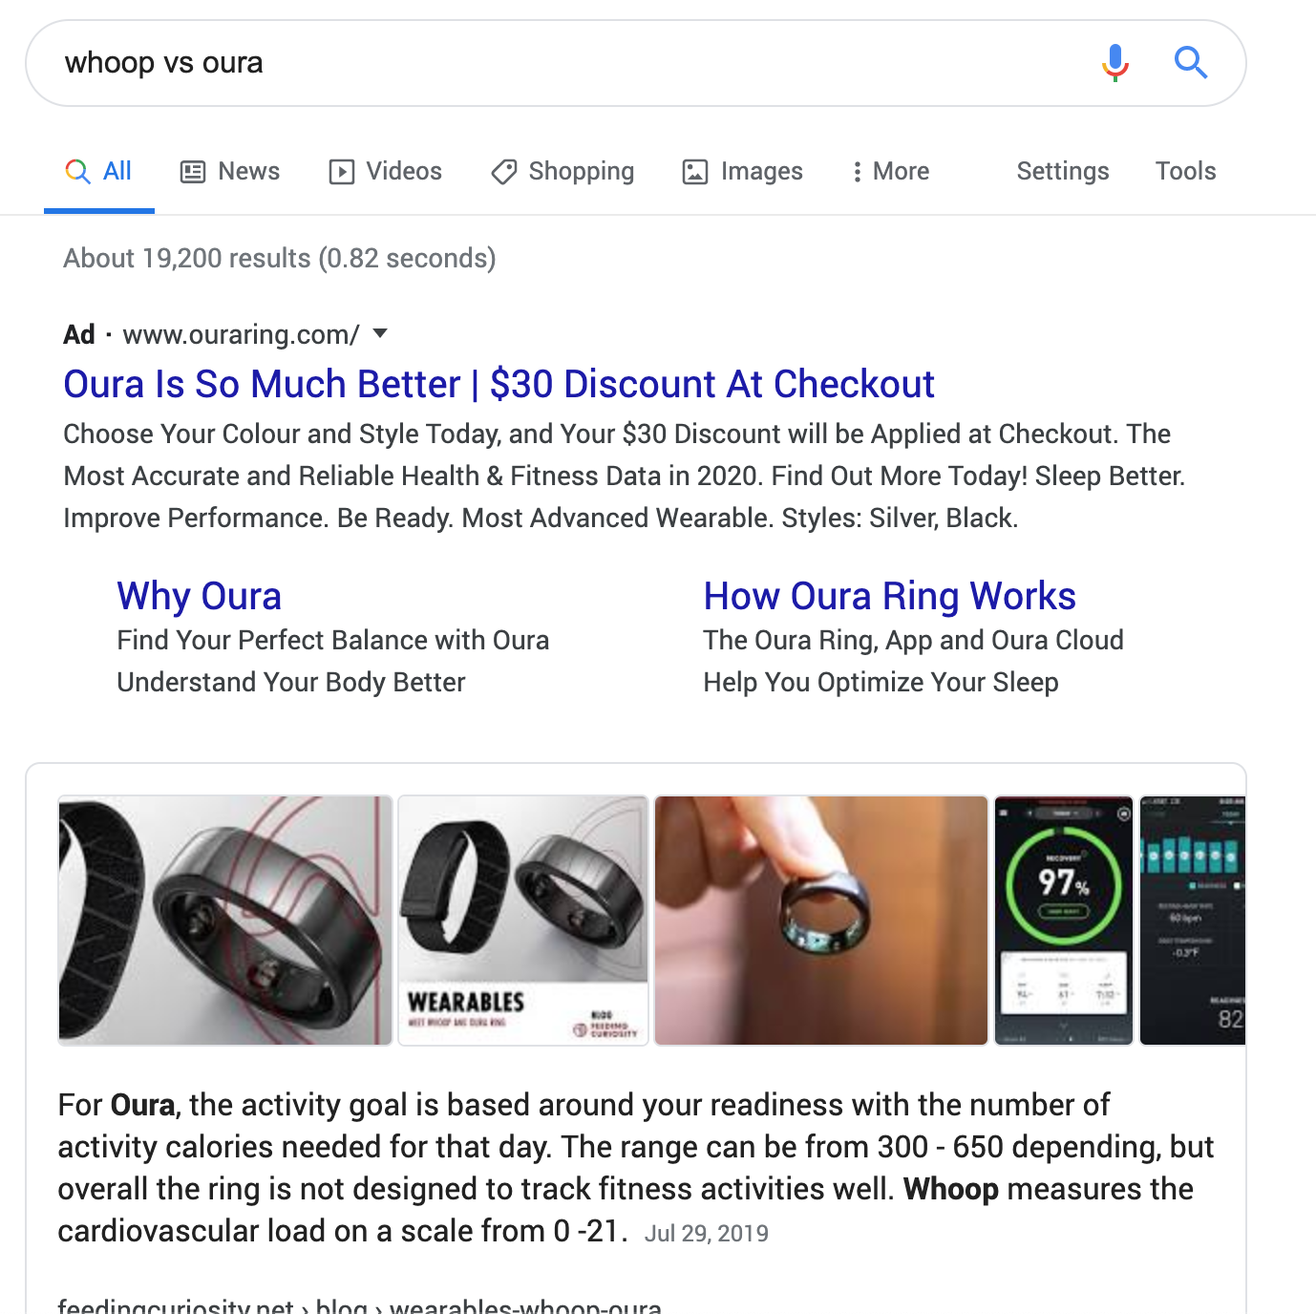
A Journey Through Search (Cont.)
Then, we move into evaluation.
Informational “versus” searches show deeper consumer purchase intent.
In the battle of Whoop versus Oura, which wins here?
Notes:
Purpose: Walk through a case study of searching for fitness trackers, focused on two competitive brands (Whoop and Oura).
TALKING POINTS:
Now we know what fitness trackers are out there. We move into evaluation, comparing two brands.
This is still informational, but intent is higher as we have that “versus” keyword.

Slide 51
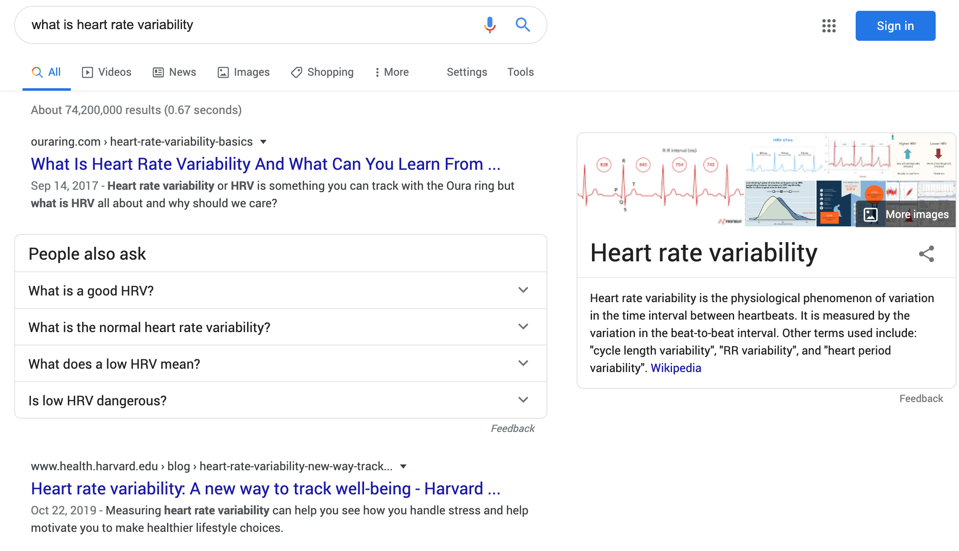
A Journey Through Search (Cont.)
We do some more research.
The consumer’s searches are more specific, and intent is building.
Which is winning here?
Notes:
Purpose: Walk through a case study of searching for fitness trackers, focused on two competitive brands (Whoop and Oura).
TALKING POINTS:
We go back to the research phase to get information about a related concept.
Notice the result at the very top? And it’s not even an ad!

Slide 52

A Journey Through Search (Cont.)
In the previous search, an Oura content page ranked No. 1. The second paragraph contains an internal sales link.
Is SEO free? Not really, but this article has been driving sales since 2017.
Notes:
Purpose: Walk through a case study of searching for fitness trackers, focused on two competitive brands (Whoop and Oura).
TALKING POINTS:
This blog wasn’t promoted, but thanks to SEO, it ranked high during the research/informational search phase and can drive sales.

Slide 53
Search Showdown
In this two-part exercise, students will compare and contrast how their paid and organic search efforts compare to that of a major competitor.
In the first part of the exercise, students should choose roles: Partner A searches for terms related to their brand and Partner B searches for terms related to a competitor. The pair should decide on a competitor, then take 5 minutes to search for brand, product, and related keywords. They should jot down notes on their observations: What is going well, what isn’t going well, what results are appearing, what terms they’re using, etc.
For Part 2, the partners should come back together to compare notes on their findings: How their brand is performing compared to the competitor. They should ultimately be able to answer: Who is owning the SERP? And why? Give students another 5 minutes to compare notes.
Afterward, lead a debrief. Have a few pairs volunteer to share who they thought was owning the SERP and why. Have them share observations of what their brand was or wasn’t doing well and how they could improve.

Slide 54


Search Showdown
5 minutes
Partner A: Search for keywords or product names that will return your brand’s search ads or webpages in the results. Jot down your observations.
Partner B: Search for keywords or products that will lead you to a competitor’s search ads or webpages. Jot down your observations.
LXA note
You can list a specific competitor here.
Notes:
Purpose: Help students realize their brand’s search performance compared to competitors’ brands.
TEACHING TIPS:
Remind students to have one person be Partner A and the other be Partner B.
Before they start searching, have them choose a competitor together.
This is Part 1 of the exercise. Part 2 is on the next slide.
For Remote deliveries:
Screenshot this slide and drop it in the Slack channel.
At the 60-second mark, send a message to all rooms that they should move on to the next part.

Slide 55

Search Showdown
5 minutes
Compare and contrast your notes on your and your competitors’ search performance.
What are you doing to beat out your competitor?
What is your competitor doing that you could do more of?
Based on the results, who is “owning the SERP”? Why?
Be ready to share your findings with the class!
Notes:
Purpose: Help students realize their brand’s search performance compared to competitors.
TEACHING TIPS:
Have students come back together to discuss their findings.
At the end of the exercise, have volunteers share what they noticed for their brand and their competitors’ pages.
For Remote deliveries:
Screenshot this slide and drop it in the Slack channel.
At the 60-second mark, send a message to all rooms: “Start to wrap up your discussions. Rooms will close in one minute!”

Slide 56
Let’s Recap
Success in social comes down to tailoring your creative and incentives to match specific audiences.
Success in search comes from owning the SERP; organic, paid, and often both.
Both social and search should focus on providing the consumer with value as opposed to blasting the marketing messages you hold dear.
Notes:
Purpose: Wrap up the section and reinforce takeaways.
TEACHING TIPS:
Check for understanding and see if students have additional questions about the material covered.

Slide 57
The eCommerce Formula: Conversion and Average Order Value
Accelerating Growth Through eCommerce
The eCommerce Ecosystem
The eCommerce Formula: Traffic
The eCommerce Formula: Conversion and AOV
The eCommerce Formula: Retention and Churn
Notes:
Duration: 105 minutes

Slide 58
Where We’re Going
Describe the importance of landing pages and product pages in driving conversions.
Evaluate landing pages and product pages to gauge their efficacy in driving conversions.
Identify tactics for increasing average order value.
Notes:
Purpose: Share the expressed learning goals with students.
For Remote deliveries:
Capture a screenshot of this slide and drop it in the class Slack channel.

Slide 59
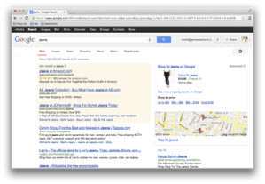
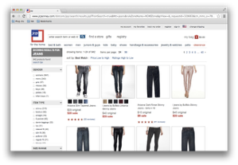
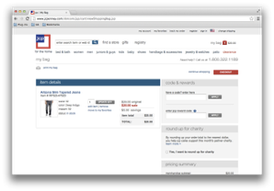
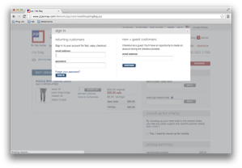
Why Conversion Is Hard
10% - 75,000
browse products page.
100% - 750,000 visitors to site.
5% - 3,750 add to cart.
40% - 1,500
sign up for account.
Notes:
Purpose: Demonstrate qualitatively why conversion rates are so difficult.
TALKING POINTS:
Of course, it’s never as simple as this diagram. People don’t really buy the first thing they search for.
Your conversion rates at each step of the funnel will vary. Analyze your funnel data to see where people drop off.
Measuring conversion rates at each meaningful step is critical for figuring out where you can make the most gains.

Slide 60
Improving Conversion Rate
Improve conversion rate with:
User flow simplicity.
Content that’s tailored to the user.
Landing pages that drive action.
Product pages that speak to user needs.
Notes:
Purpose: Share best practices for improving conversions.
TALKING POINTS:
When we are thinking about conversion rate here, we are going to talk about getting people to make a purchase.
There are many ways to improve conversion rates for the eCommerce world. This is just a sampling of techniques for doing so.
We’ll be focusing closely on landing pages and product pages in this section.

Slide 61

The Purpose Of Landing Pages
Keep the messaging consistent between ads and action.
Drive users to convert by taking one (and only one) critical action.
Notes:
Purpose: Describe what purpose landing pages serve in the eCommerce flow.
TALKING POINTS:
The ultimate goal of a landing page is to convert customers; to get them to take some action.
Consistency and clarity are keys for getting there.

Slide 62
Good Landing Pages
Reflect exactly what the user did prior to arriving there.
Drive the user to take a single action.
Provide secondary information that research shows users want.
Are easy to understand.
Are thumb- and mobile-friendly.
Notes:
Purpose: Describe what makes a good landing page.
TALKING POINTS:
Good landing pages are clear, consistent, and easy to understand.
They contain only the relevant information needed and get users to take a single action.

Slide 63
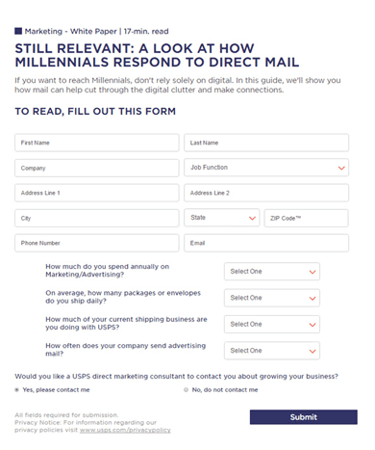
Would You Convert?
LXA note
Swap out example with one more relevant to client.
Notes:
Purpose: Help students internalize how bad landing pages can harm conversions.
TEACHING TIPS:
Have a few students shout out answers and why.
The ultimate answer should be, “No, you would not convert for a landing page like this.”
There are too many fields and it would not be worth it.
For Remote deliveries:
Students can come off mute to share responses or add their response in the Zoom chat.

Slide 64
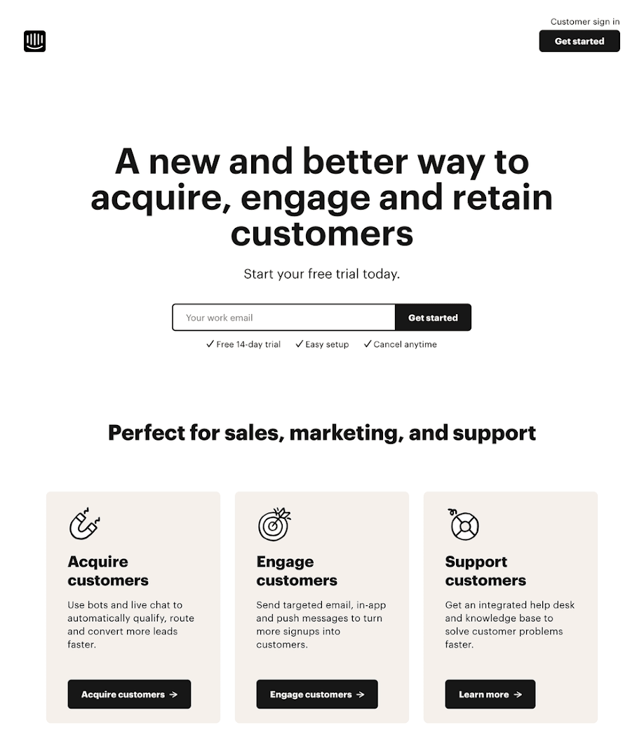
What About Here?
LXA note
Swap out example with one more relevant to client.
Notes:
Purpose: Show the contrast of a good landing page.
TEACHING TIPS:
Have a few students shout out answers.
The ultimate answer is, “Yes, you would convert here.”
Ask: Why would you convert here? What does this page do well that the other one doesn’?
For Remote deliveries:
Students can come off mute to share responses or add their response in the Zoom chat.

Slide 65
Landing Page Exploration
This exercise has two components that build on each other.
In Part 1, exploration, partners should Google the brands listed on the slide with the goal of finding one of their landing pages. They should click on the paid ads that appear for that brand at the top of the search results and navigate to the landing page. (If they are having trouble finding landing pages for those brands, that’s OK. They can choose a competitor or another brand.) For each landing page they visit, they should note down what is and isn’t working about it. They will use these notes in the second part of the exercise (design studio). Give students 10 minutes to explore the pages.
To debrief, have a few students share out the landing pages that they visited and what worked or didn’t work about them. Draw out some key themes from their observations about what does or doesn’t make an effective landing page to build on the previously shared best practices.

Slide 66
Landing Page Exploration
10 minutes
LXA note
Swap out brands with ones more relevant to client.
Google the following and click on the ads that appear:
Shopify
GEICO auto insurance
Casper mattresses
Zoom video conferencing
Make note of:
What works about the landing page?
What doesn’t work?
How does the landing page drive conversions?
Notes:
Purpose: Have students explore what makes a landing page effective or ineffective in practice.
TALKING POINTS:
When you Google these brands, make sure that you’re clicking on the paid search ad at the top of the results.
Landing pages generally follow paid ads, not organic search results.
TEACHING TIPS:
If students aren’t finding the actual landing pages, have them google non-brand terms related to each brand.
The design studio activity in a few slides builds on findings from this activity.
After the exercise is over, have a few students share their observations of what does/doesn’t work.
For Remote deliveries:
Screenshot this slide and drop it in the Slack channel.
At the 60-second mark, send a message to all rooms: “Start to wrap up your discussions. Rooms will close in one minute!”

Slide 67

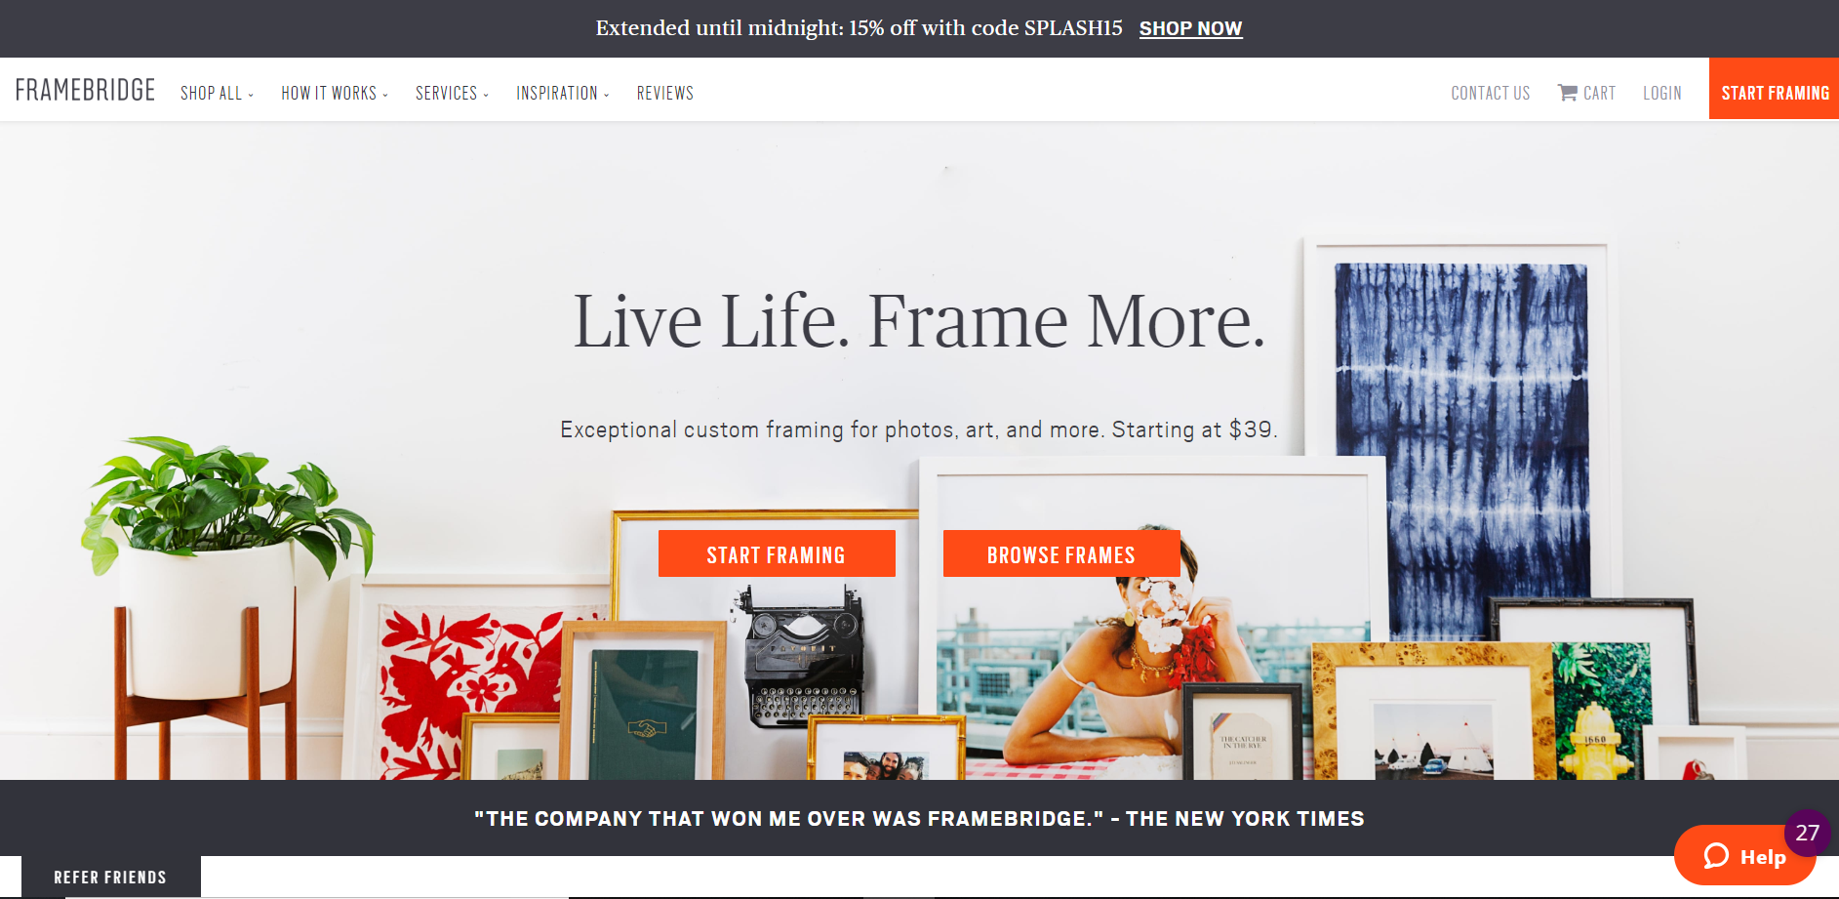
Landing Page Dissection
LXA note
Swap out example with one more relevant to client. This builds over four slides.
What do these do?
Notes:
Purpose: Walk through the elements of a real landing page.
TEACHING TIPS:
Overall, this example represents a good landing page design.
Ask students what purpose the highlighted element serves on the page and how it drives conversions.
Have students shout out responses.

Slide 68
Landing Page Dissection (Cont.)
What does this do?
Notes:
Purpose: Walk through the elements of a real landing page.
TEACHING TIPS:
Overall, this example represents a good landing page design.
Ask students what purpose the highlighted element serves on the page and how it drives conversions.
Have students shout out responses.

Slide 69
Landing Page Dissection (Cont.)
What does this do?
Notes:
Purpose: Walk through the elements of a real landing page.
TEACHING TIPS:
Overall, this example represents a good landing page design.
Ask students what purpose the highlighted element serves on the page and how it drives conversions.
Have students shout out responses.

Slide 70

Landing Page Dissection (Cont.)
This interstitial pops up after about 10 seconds on-site. What does it do?
Notes:
Purpose: Walk through the elements of a real landing page.
TEACHING TIPS:
Overall, this example represents a good landing page design.
Ask students what purpose the highlighted element serves on the page and how it drives conversions.
Have students shout out responses.

Slide 71
Landing Page Design Studio
This exercise builds on the previous exploration exercise.
Students should choose one of the landing pages that they observed in the previous activity. Using their notes and the best practices discussed, they should sketch out an optimized version of the landing page. If students are struggling to decide which page to optimize or think that the examples they found were all pretty good, encourage them to use the bad example on the slide (it was discussed earlier in the lesson). They can use paper/pen, whiteboard, or PPT/slides to sketch their optimized version. Give students 15 minutes to draw their improvements.
To debrief, have a few volunteers share their drawing with the class. Ask them to talk through what improvements they made and why they chose to make them. Have them explain what makes their version of the landing page better than the existing one.

Slide 72
Landing Page Design Studio
15 minutes
Choose one of the landing pages you analyzed during your exploration.
Based on the observations you wrote down, create a sketch of an optimized version of that landing page.
(Couldn’t find a really bad example? Try optimizing the landing page at right.)
Notes:
Purpose: Apply learnings to the design of an actual landing page.
TEACHING TIPS:
This activity builds on the previous exploration activity.
If students are struggling to decide which to optimize or think that the examples they found were all solid, encourage them to use the bad example on this slide.
At the end of the activity, invite a few volunteers to demo the actual landing page (“the before”) and their optimized version (“the after”). Have them explain the updates they made and why.
For Remote Classrooms:
Screenshot this slide and drop it in the Slack channel.
Have students take a picture of their sketch (or save the digital copy) and add their work in the Slack thread.
At the 60-second mark, send a message to all rooms: “Start to wrap up your discussions. Rooms will close in one minute!”
Take a moment to review the responses and select 2–3 for the wider class to discuss.

Slide 73
What Makes a Good Product Page?
1
Clear CTA.
5
Reflects the brand.
2
Appealing product photography.
6
Sounds human.
3
Descriptive product photography.
7
Highlights social proof.
4
Description speaks to consumer needs.
8
Clear images of modification options.
Notes:
Purpose: Introduce best practices for product page design.
TALKING POINTS:
Product pages are equally important as driving conversions.
It’s where customers can learn about and purchase the product.

Slide 74
Product Pages Across the Models
DTC
Most control; you own the page.
eRetail
Some control; partner with retailer.
Amazon
Less control; can pay for additional features.
Notes:
Purpose: Acknowledge the differing levels of control that brands have on product pages on different platforms.
TALKING POINTS:
You have the most control on product pages in the DTC model, as you own the pages.
You have some, but not as much, influence in eRetail, and you can build a relationship with the retailer to make updates to the page (and pay for promotions).
With Amazon, you provide the product description and images as you would on another platform. However, all of the additional features that make Amazon product pages unique are additional paid options that you can purchase to customize your product page.

Slide 75

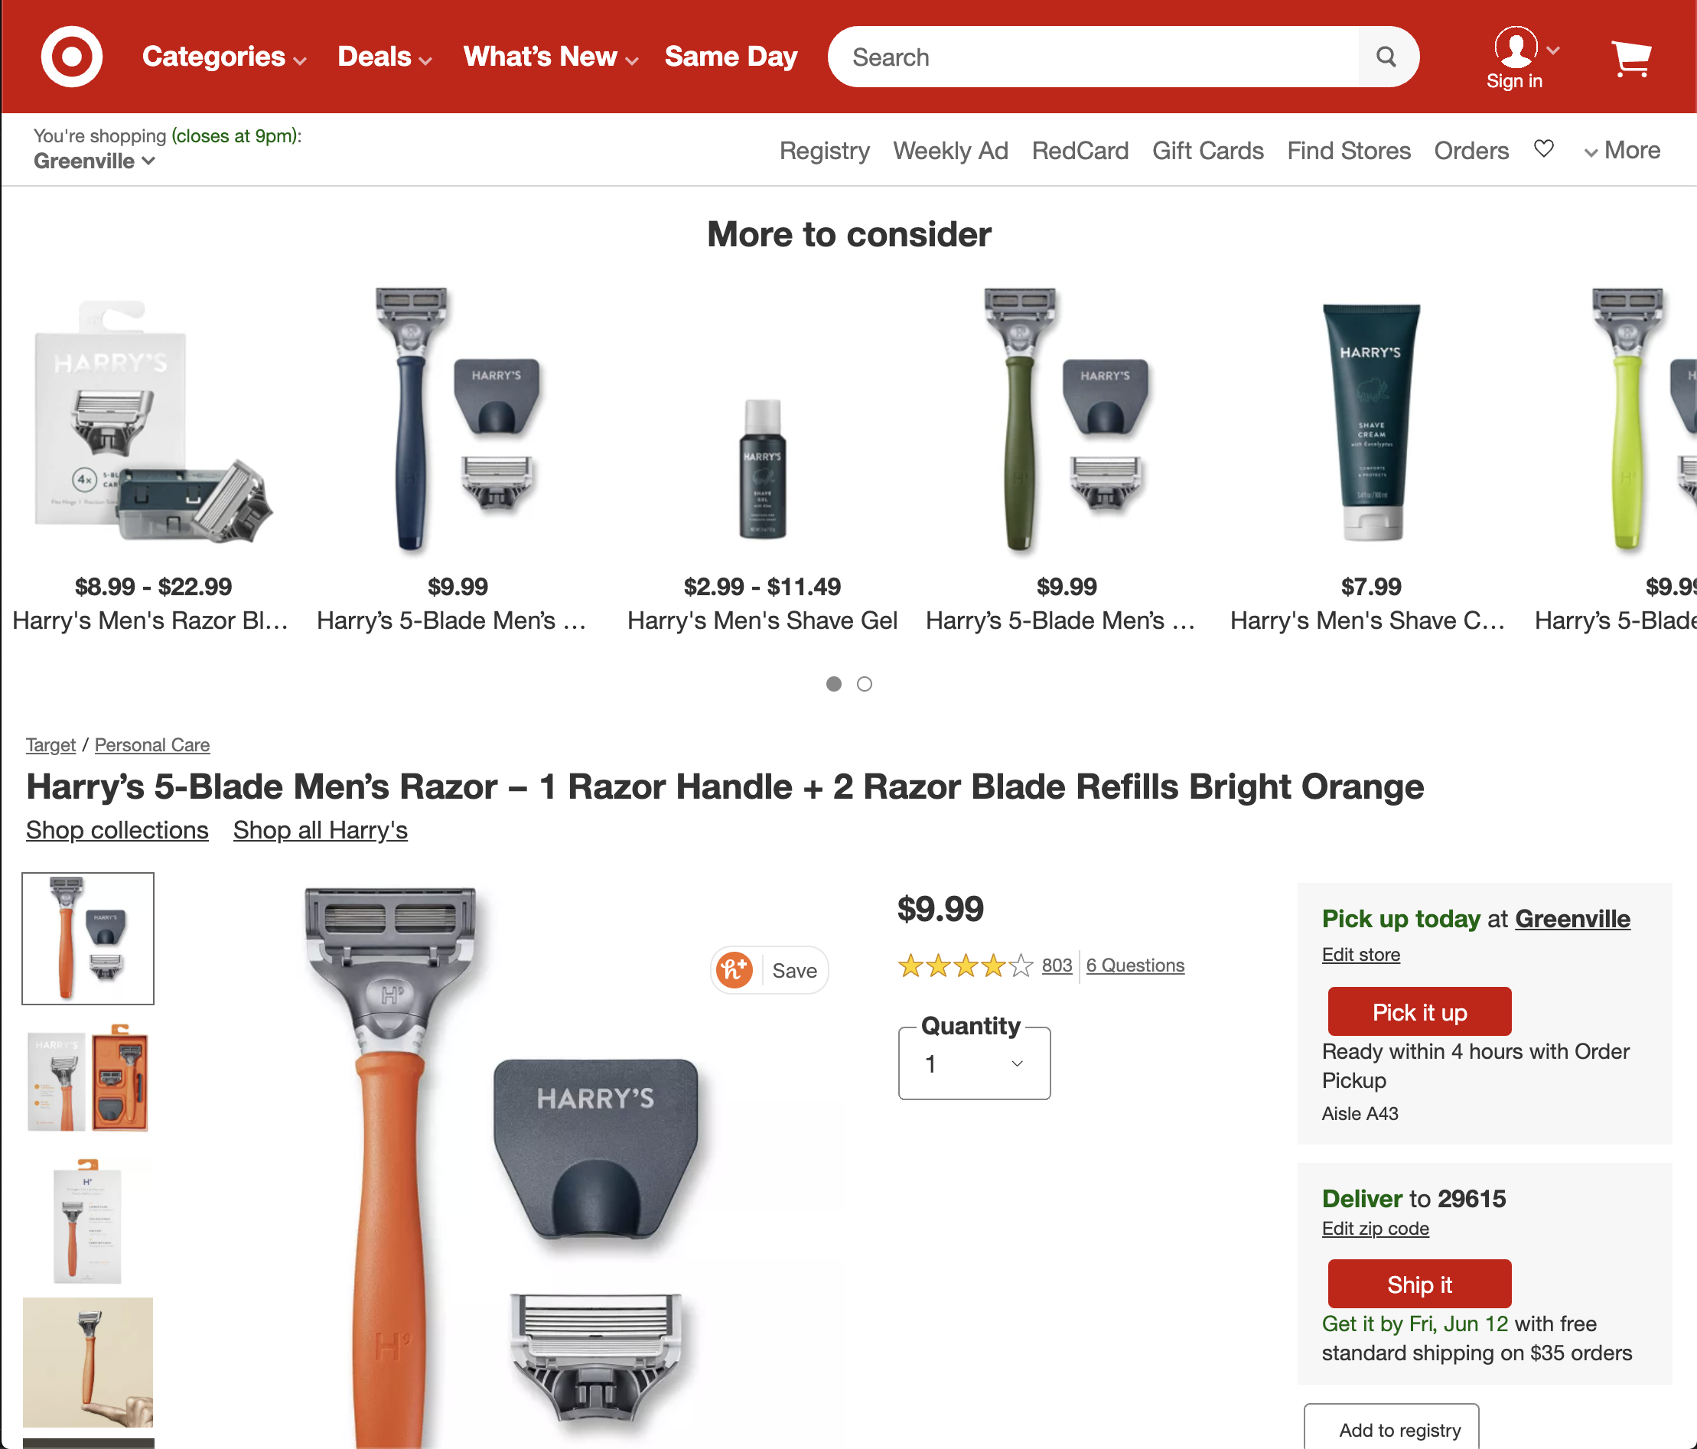
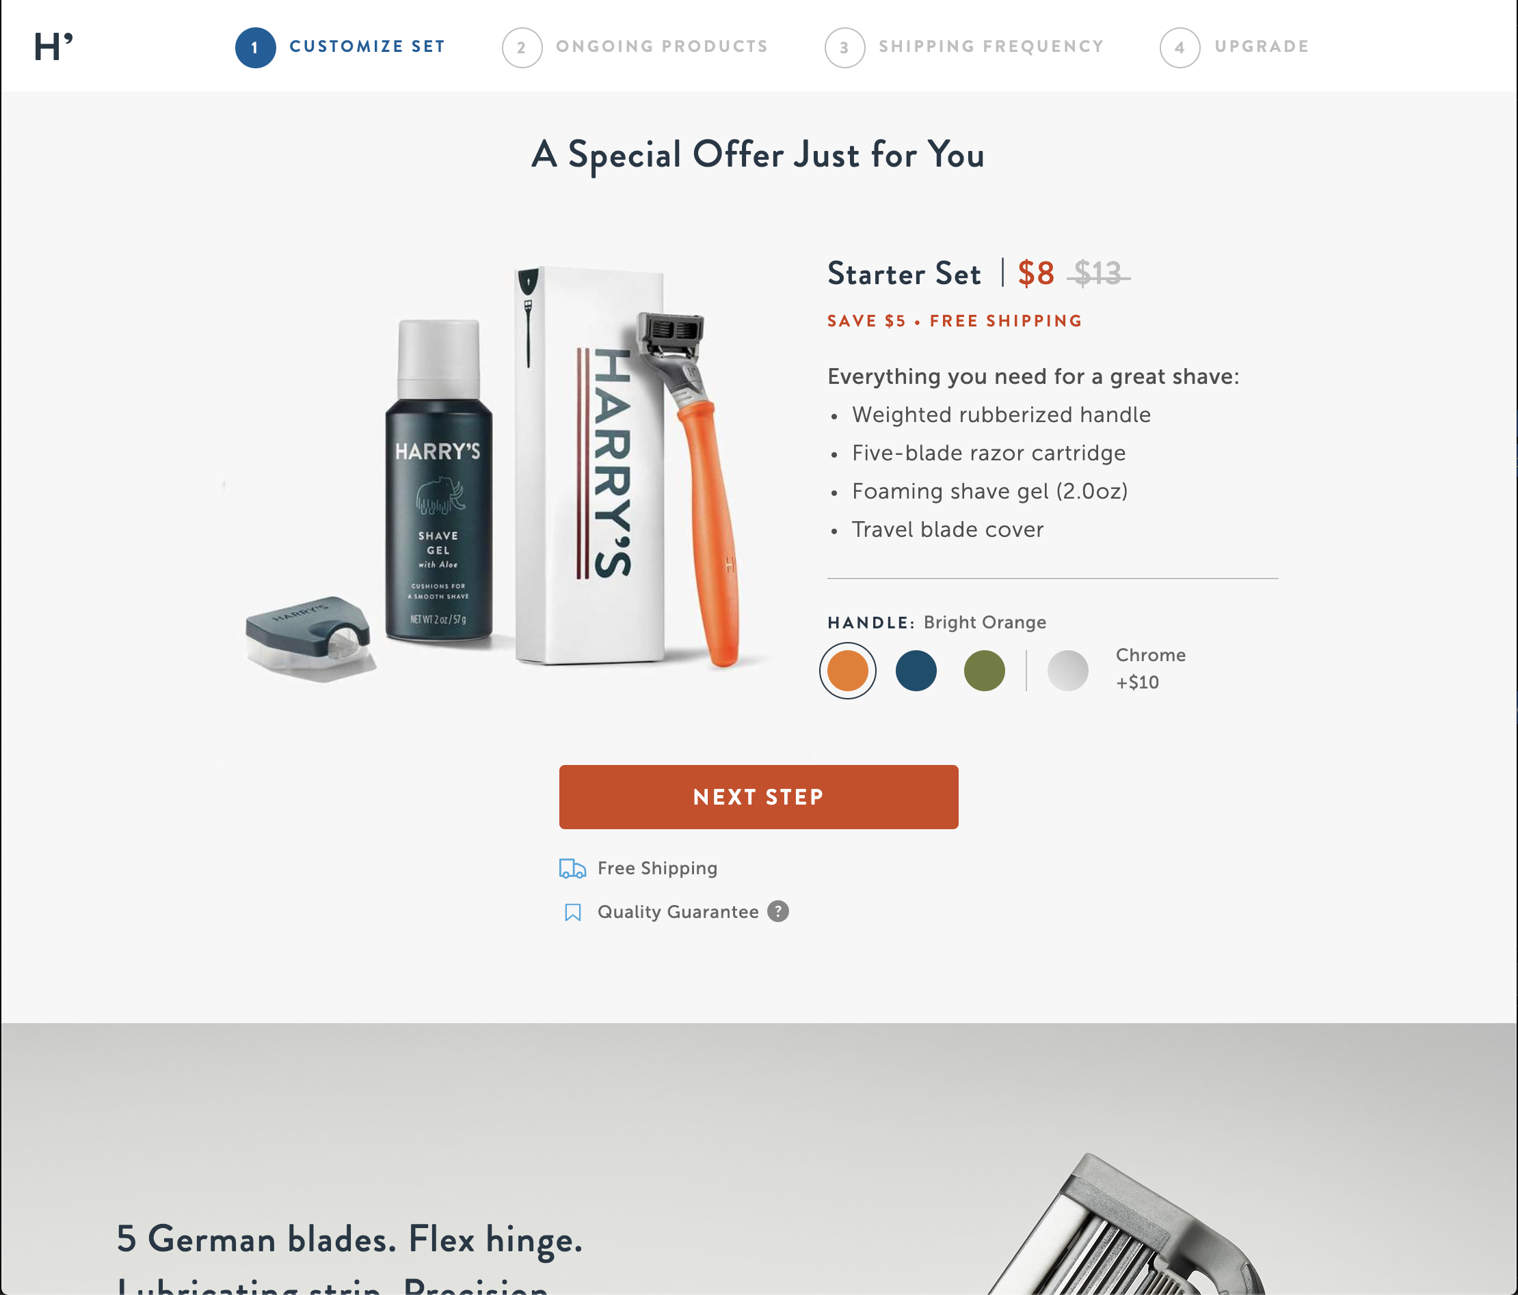
Harry’s eRetail vs. Harry’s DTC
LXA note
Swap out example with one more relevant to client.
Notes:
Purpose: Show product pages for the same product on different platforms.
TEACHING TIPS:
Ask: What do you notice about the two product pages? What’s different on Target versus the DTC site?

Slide 76
Evaluating Our Product Pages
In this exercise, students will review their brand’s own product pages and identify how they are or aren’t working based on the product page criteria we reviewed. Students can select product pages from any of the three eCommerce models (DTC/their own site, eRetail/a retailer site, or Amazon). For the sake of time, they should stick with this one platform but can browse a few different product pages on that platform.
After observing a few product pages, students should make note of how the pages perform against the eight criteria reviewed as a class. Which criteria are or aren’t being met? They should also suggest two specific improvements to make to the product pages to drive conversions. Give students 10 minutes for their observations.
To debrief, have one group share out for each platform (DTC, eRetail, Amazon). Have that group share what is or isn’t working about their brand’s product pages on that platform, as well as the specific improvements they’d make.

Slide 77
Evaluating Our Product Pages
10 minutes
LXA note
You can focus the exercise on just 1–2 platforms, not all three.
Pull up a product page for a few of your products on any eCommerce platform (DTC, eRetail, or Amazon).
Evaluate the pages against the best practices and jot down your observations.
Which criteria are we meeting?
Which are we not meeting?
Suggest two improvements that would drive conversions.
1 | Clear CTA.
2 | Appealing product photography.
3 | Descriptive product photography.
4 | Description speaks to consumer needs.
5 | Reflects the brand.
6 | Sounds human.
7 | Highlights social proof.
8 | Clear images of modification options.
Notes:
Purpose: Analyze how they are using product pages today.
TEACHING TIPS:
Remind students that they can pick a product page for their products on any platform that’s relevant or interesting to them: their DTC site, an eRetailer’s site, or on Amazon.
Try to make sure that each eCommerce model is represented by at least one group (unless their brand is not using one).
Depending on time, they can look at a few product pages on that platform.
At the end of the exercise, have at least one pair for each model share their observations.
For Remote deliveries:
Screenshot this slide and drop it in the Slack channel.
At the 60-second mark, send a message to all rooms: “Start to wrap up your discussions. Rooms will close in one minute!”

Slide 78
So You Got Them to Convert…
Traffic
Conversion Rate
Average Order Value
Revenue
x
x
=
Total revenue / total number of orders
Notes:
Purpose: Connect the concept of average order value to conversions and the eCommerce flow.
TALKING POINTS:
Once you get them to convert and make a purchase, the process isn’t over!
Driving average order value is an important metric for eCommerce success.
Even if conversion rates are relatively low, if you can drive a relatively high AOV, you’ll be able to generate significant revenue.

Slide 79

The Importance of AOV
LXA note
Swap out example with one more relevant to client.
Let’s imagine a lamp store that sells lamps in three sizes:
Small ($15)
Medium ($20)
Large ($30)
Last quarter, the AOV was $21.
What does this tell us about which products are selling?
$15
$20
$30
Source: Apruve
Notes:
Purpose: Underscore another way that AOV can be helpful.
TALKING POINTS:
AOV can also tell you which of your products are selling more and what customers are buying.
TEACHING TIPS:
ASK: What products are selling, based on what we know about the lamp prices and AOV?
Answers: The lower-priced options are selling more frequently than the higher-priced, and multiples of the lower-priced options are selling.

Slide 80


The Importance of AOV
Understand customer buying patterns.
Incrementally increase revenue.
Improve the ROI of marketing tactics.
Notes:
Purpose: Summarize the insights that AOV can provide.
TALKING POINTS:
AOV can help you understand what customers are buying, increase revenue, and improve your marketing ROI.

Slide 81

Tactics for Increasing AOV
Bundle products.
Provide product recommendations.
Leverage shipping offers.
Set order minimums for free shipping.
Offer cart add-ons.
Upsell or cross-sell.
Notes:
Purpose: Share best practices for increasing AOV.
TALKING POINTS:
You can increase AOV by implementing tactics like these.
Many of these play into the design of your product pages and landing pages, as well as other tactics such as email and your other websites.

Slide 82
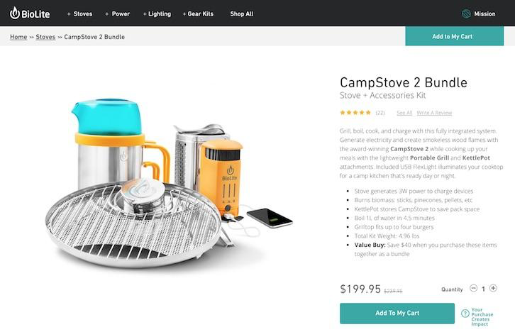
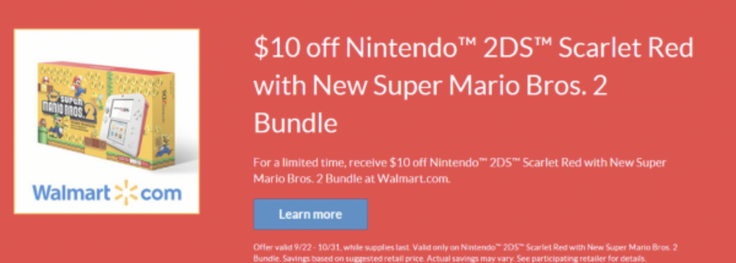
Product Bundling
LXA note
Swap out example with one more relevant to client.
Notes:
Purpose: Review best practices for increasing AOV.
TALKING POINTS:
One way to increase AOV is by providing bundles of products.
Bundles reduce the total price of the items, offering a “value buy” as described here by BioLite.

Slide 83
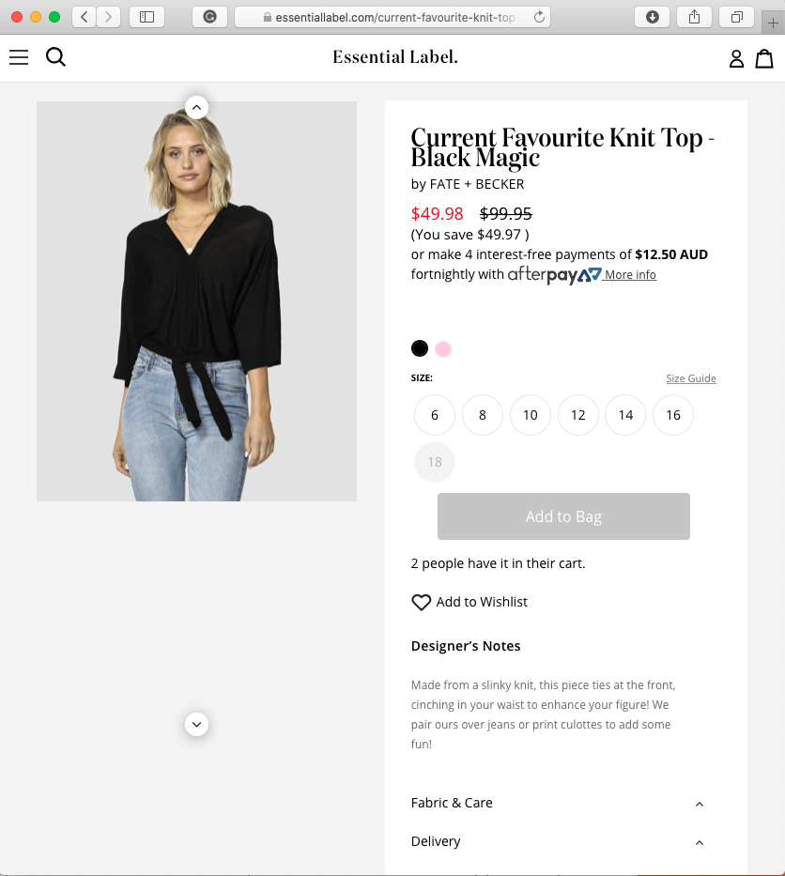
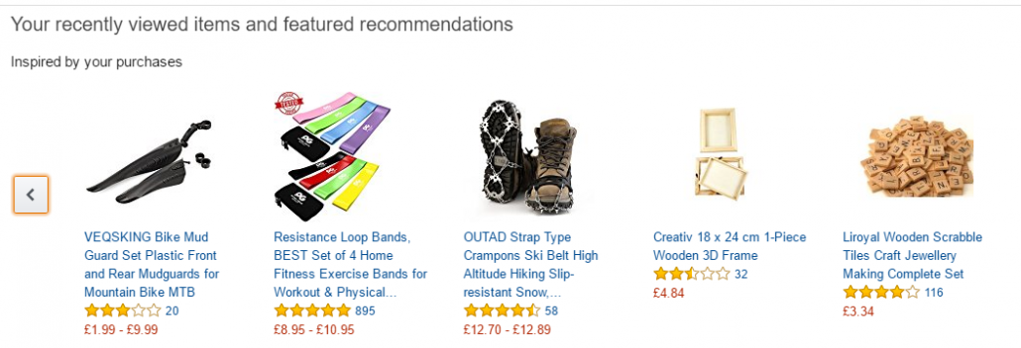
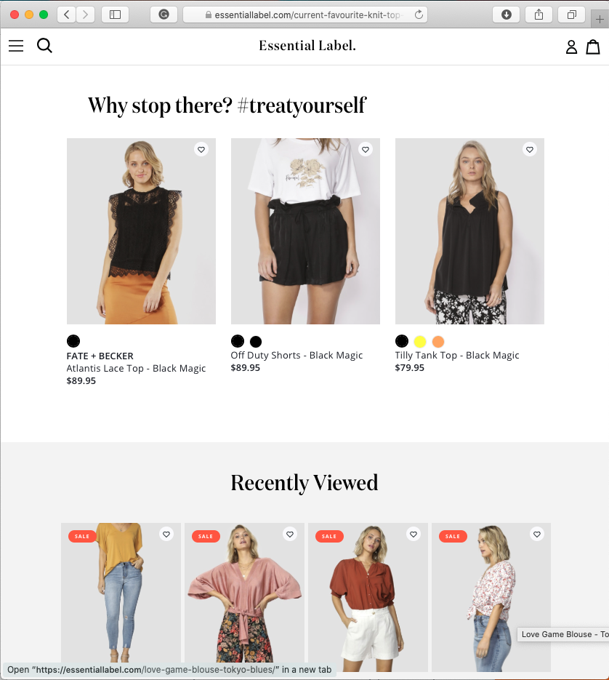
Product Recommendations
LXA note
Swap out example with one more relevant to client.
Notes:
Purpose: Review best practices for increasing AOV.
TALKING POINTS:
Similar to bundling, product recommendations can increase AOV.
Amazon set the standard for product recommendations with its complex recommendation algorithms based on customer purchase and browsing habits.
Other, smaller brands such as Essential Label also use product recommendations with the incentive of #treatyourself.

Slide 84
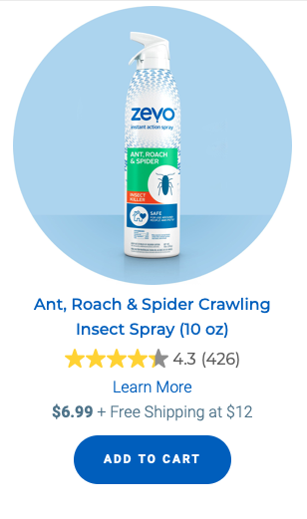
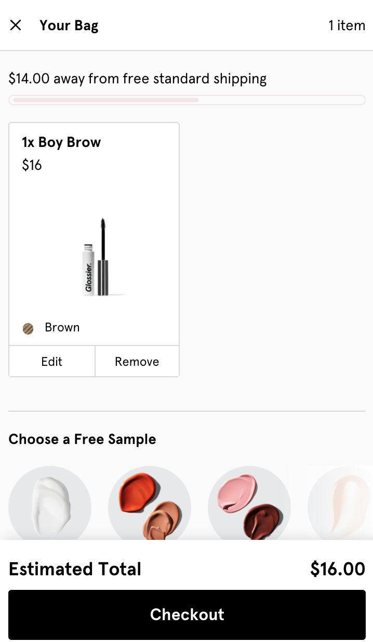
Shipping Offers
LXA note
Swap out example with one more relevant to client.
Notes:
Purpose: Review best practices for increasing AOV.
TALKING POINTS:
Shipping offers are a great way of increasing AOV.
Offering a free shipping deal once customers have at least a certain purchase amount or a certain number of items in their cart can drive AOV.

Slide 85
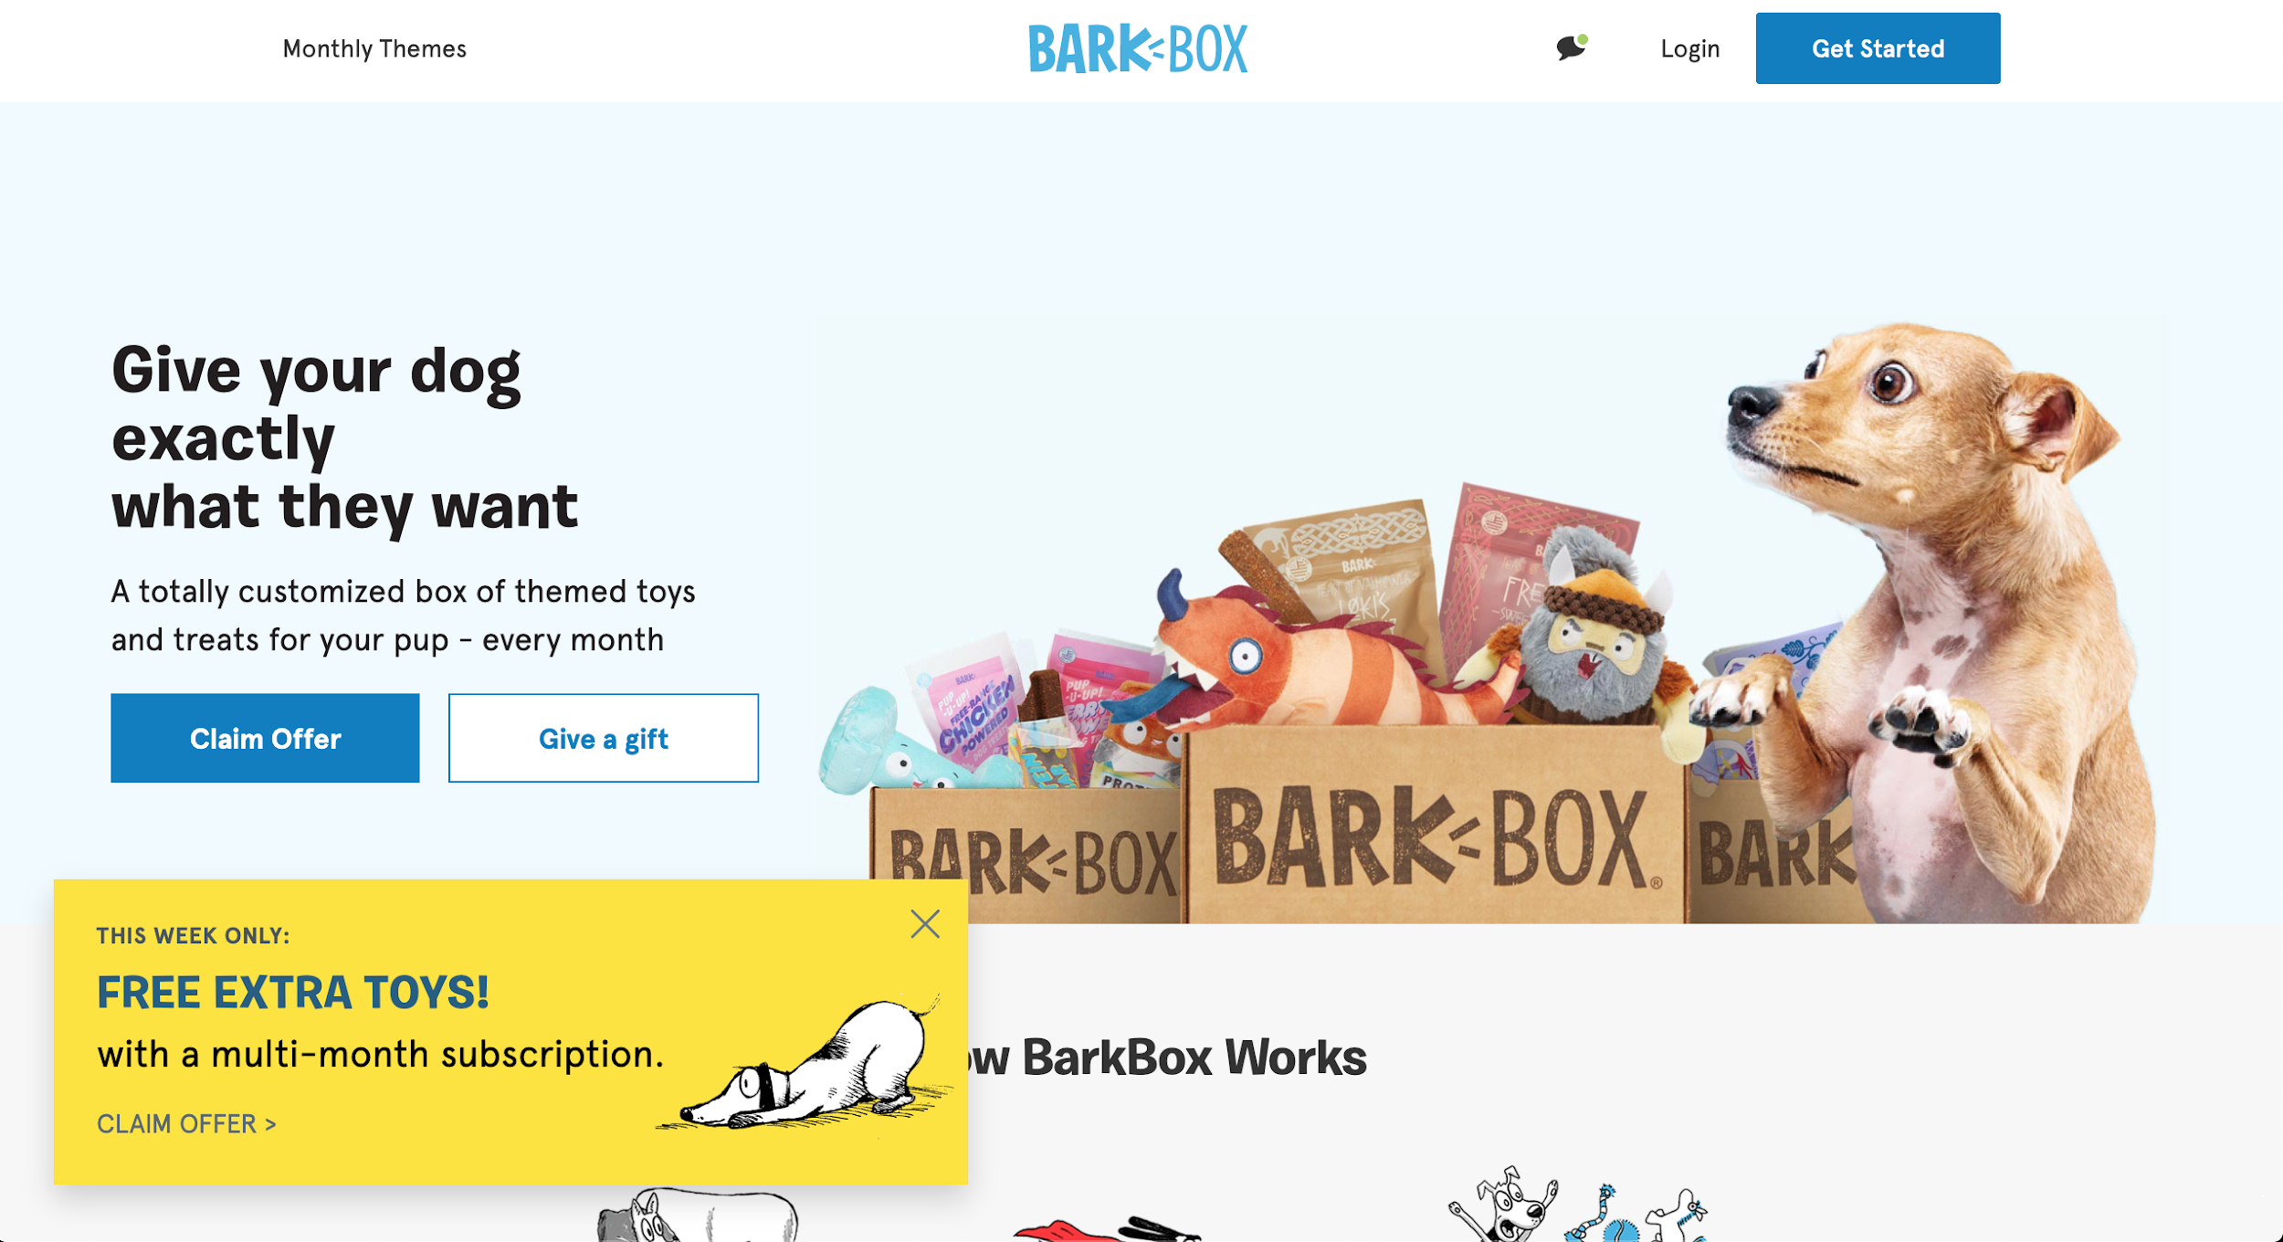
Make It Time-Sensitive
LXA note
Swap out example with one more relevant to client.
Notes:
Purpose: Review best practices for increasing AOV.
TALKING POINTS:
Time-sensitive offers drive urgency and increase the likelihood of improving AOV.
The “this week only” incentive from BarkBox encourages customers to purchase a subscription.

Slide 86
AOV Optimization
What is the biggest opportunity to improve AOV for your eCommerce business?
Which of the tactics we reviewed can have the most impact for you in terms of driving AOV?
Notes:
Purpose: Lead a debrief around optimizing and improving AOV.
TEACHING TIPS:
Have a few students shout out answers for each category.
For Remote deliveries:
Students can come off mute to share responses or add their response in the Zoom chat.

Slide 87
Let’s Recap
Keeping landing pages and product pages simple and clear is key to driving customers to convert.
Make conversions even more impactful by focusing on increasing average order value (AOV).
Tactics such as bundling, product recommendations, and free shipping offers can help drive AOV.
Notes:
Purpose: Wrap up the section and reinforce takeaways.
TEACHING TIPS:
Check for understanding and see if students have additional questions on the material covered.

Slide 88
The eCommerce Formula: Retention And Churn
Accelerating Growth Through eCommerce
The eCommerce Ecosystem
The eCommerce Formula: Traffic
The eCommerce Formula: Conversion and AOV
The eCommerce Formula: Retention and Churn
Notes:
Duration: 60 minutes

Slide 89
Where We’re Going
Explain the difference between retention rate and churn rate.
Describe why email is such an important channel for customer retention.
Choose the email tactics that will reengage and win back customers.
Notes:
Purpose: Share the expressed learning goals with students.
For Remote deliveries:
Capture a screenshot of this slide and drop it in the class Slack channel.

Slide 90

How Retention Fits In
Building relationships that keep customers coming back is just as essential to a successful eCommerce business as driving traffic and conversions.
Bain & Co. estimates that a 5% increase in customer retention can boost a company’s profitability by 75%.
Source: Big Commerce
Notes:
Purpose: Emphasize the importance of retention.
TALKING POINTS:
Driving traffic and purchasing behavior is only the start.
Retaining customers and keeping them coming back to purchase will drive long-term results.

Slide 91
What’s the Difference?
Churn rate
Percentage of customers who are lost over a given period of time.
Retention rate
Percentage of customers who return and continue doing business with you.
vs.
Notes:
Purpose: Differentiate between churn rate and retention rate.
TALKING POINTS:
Churn rate is how fast you’re losing customers.
Retention is how long customers continue to do business with you, on average.
Both metrics are important to understanding business success in eCommerce.

Slide 92
Email for Everything
Email is the star of the show when it comes to customer retention.
Notifications and confirmations | A great opportunity to build a relationship with customers and show your brand’s personality.
Replenishment emails | Encourage customers to repurchase when they’ve potentially run out of a product.
Reengagement emails | Outreach to customers who you haven’t heard from or sold to in a while.
Winback emails | Winning back lost or churned customers.
Notes:
Purpose: Demonstrate how email can reduce churn and improves retention.
TALKING POINTS:
When it comes to keeping customers, email is the crucial channel.
Emails can serve a variety of different purposes, from logistical notifications, to reminders to purchase a product again, to engaging lost customers.
Replenishment, reengagement, and winback emails are generally what we think about when we consider using email for retention and churn.

Slide 93

Email Treasure Hunt
5 minutes
Look through your email inbox at messages that you’ve recently received from brands.
From your inbox, choose 1–2 emails that you found engaging. Make note of:
What engaged you and why.
Which type of email it is (notification/confirmation, replenishment, reengagement, or winback).
Notes:
Purpose: Internalize how brands use email in eCommerce.
TEACHING TIPS:
The goal of the exercise is to get students to look for emails of their own and think about how emails have impacted their buying habits.
At the end of the exercise, have a few volunteers share their good/bad email examples and why they thought they were good/bad.
For Remote deliveries:
Screenshot this slide and drop it in the Slack channel.
For solo activities, you can choose to put people in group breakout rooms (to recreate the “table” group from a physical setting) or allow students to work independently in the main session.
At the 60-second mark, send a message to all rooms: “Start to wrap up your work. Rooms will close in one minute!”

Slide 94
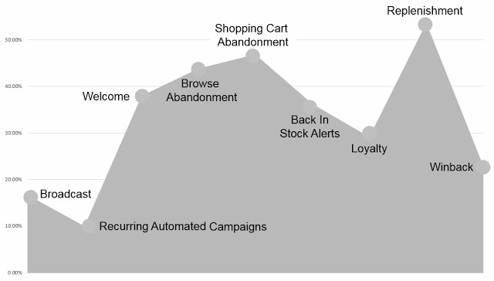
Which Emails Work?
Replenishment emails have the highest click-to-open rate at 56%.
Targeted reengagement emails (abandonment, back-in-stock alerts, loyalty) have high engagement.
Winback emails are the last line of defense in combating customer churn.
Source: Listrak
Notes:
Purpose: Compare engagement rates across different email types.
TALKING POINTS:
Reengagement emails actually have relatively high engagement rates, especially compared to regular, automated email campaigns or broadcasts.
Replenishment and shopping cart abandonment have the highest click-to-open rate, and those are the ones most directly related to conversions!

Slide 95
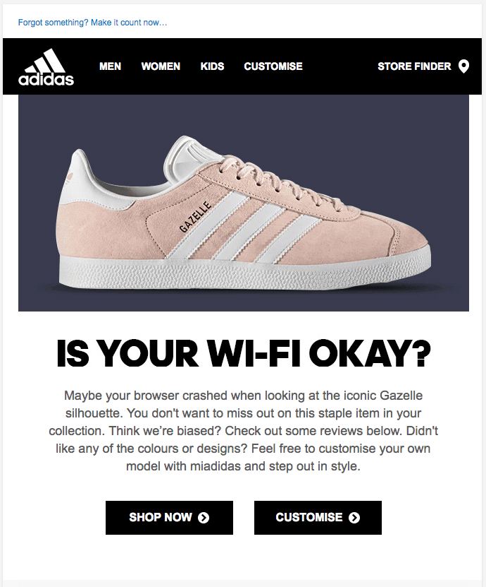
Abandonment Reminders
LXA note
Swap out example with one more relevant to client.
Notes:
Purpose: Share examples of targeted re-engagement emails.
TALKING POINTS:
This example effectively uses humor and on-brand language to bring a customer back to the shopping experience after they’ve abandoned a browsing session.
A similar approach can be taken for cart abandonment, when a customer leaves items in their cart without checking out.

Slide 96
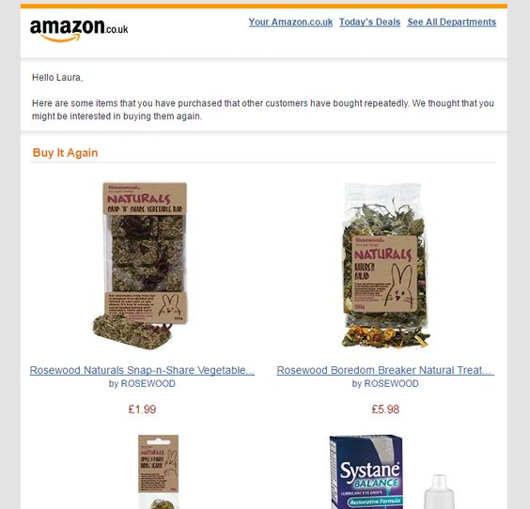
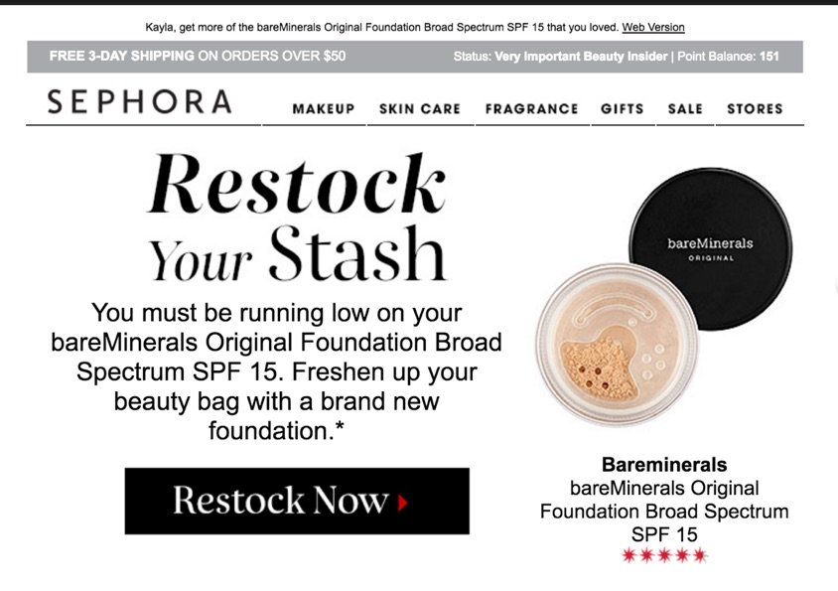
Replenishment Reminder
LXA note
Swap out example with one more relevant to client.
Notes:
Purpose: Share examples of targeted re-engagement emails.
TALKING POINTS:
Replenishment emails remind customers of when they might be running out of a product and encourage them to buy it again.
These are targeted and personalized; this example highlights the exact product the user bought before, both in the body copy and the visual.
This level of personalization is effective in engaging customers and driving retention.

Slide 97
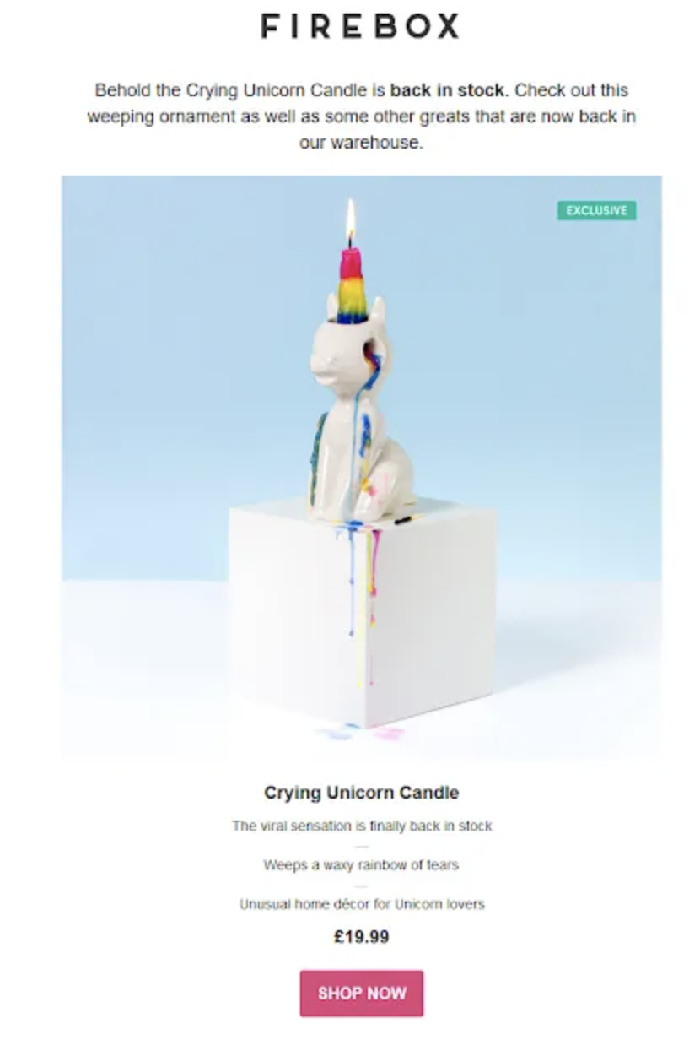
Back-in-Stock Reminders
LXA note
Swap out example with one more relevant to client.
Notes:
Purpose: Share examples of targeted re-engagement emails.
TALKING POINTS:
Back-in-stock reminders tell users when products that they’ve indicated interest in are available.
Often, a customer will elect to get an email reminder for back-in-stocks, which indicates high intent to purchase.

Slide 98

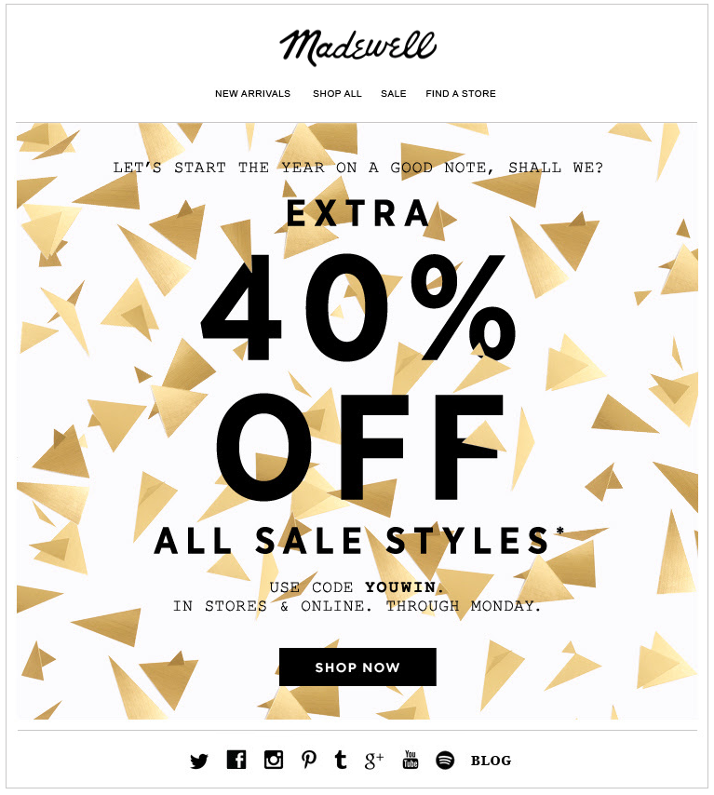
Make It Seasonal
LXA note
Swap out example with one more relevant to client.
Notes:
Purpose: Share examples of targeted reengagement emails.
TALKING POINTS:
Holidays and major events can also be great opportunities for reengaging a customer.
Instead of sending emails at random time intervals, reengagement emails that focus on a holiday or specific event seem more relevant to customers.
They also may include time-sensitive offers.
The birthday email shown here is another example of personalization and building a relationship with the customer.

Slide 99

It’s Winback Time
Haven’t heard from a customer in a while? They may have churned.
It’s time to win them back!
Reengage lapsed customers.
Incentivize them to return.
Confirm they want to unsubscribe.
Notes:
Purpose: Describe the purpose of a winback email.
TALKING POINTS:
Winback emails are specifically targeted at customers who have churned or not made a purchase in a certain time period.
They often incentivize the customer to return and make a purchase.
They also may take a different approach and give the customer the opportunity to officially unsubscribe or end the relationship.

Slide 100
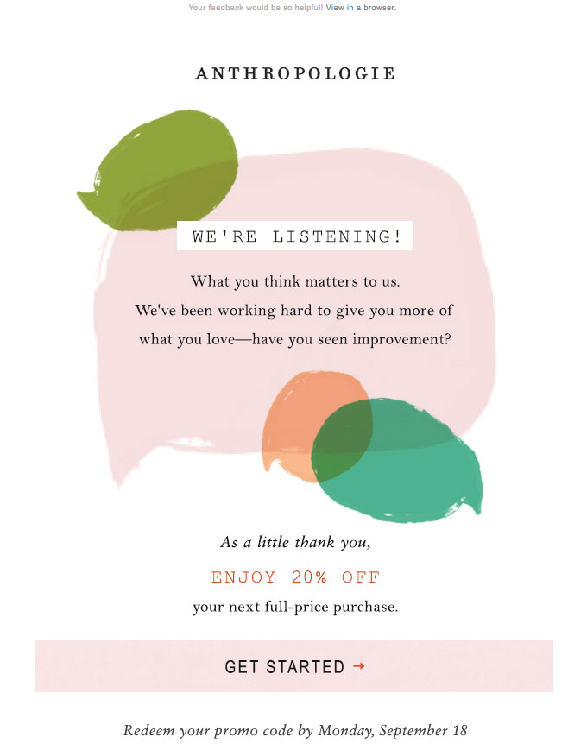
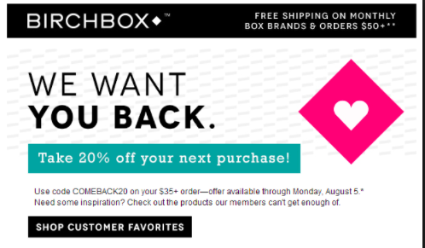
Offer Incentives
LXA note
Swap out example with one more relevant to client.
Notes:
Purpose: Share examples of winback emails.
TALKING POINTS:
Winback emails often may include an incentive to encourage customers to make a purchase.
This Birchbox email is also very upfront about what’s going on: It knows the customer has churned and the customer may know it, too.
The Anthropologie email offers an incentive with a catch: Complete a survey so that the brand can better understand why this customer churned.

Slide 101
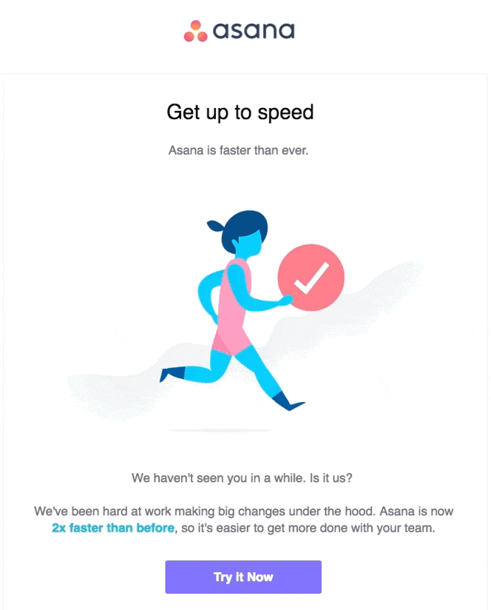
Show What’s New
LXA note
Swap out example with one more relevant to client.
Notes:
Purpose: Share examples of winback emails.
TALKING POINTS:
You can also “incentivize” customers to come back by highlighting new or improved features since the last time they bought or interacted with your product.

Slide 102
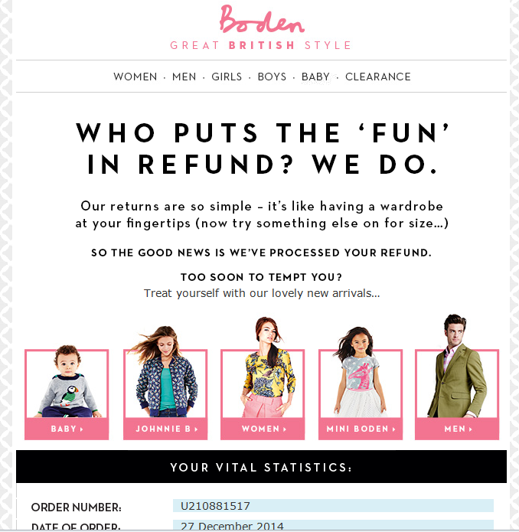
Get Creative With Refunds
LXA note
Swap out example with one more relevant to client.
Notes:
Purpose: Share examples of winback emails.
TALKING POINTS:
A winback email like this one capitalizes on a refund, which may seem like a sign that a customer is churning or disengaging.
Using this opportunity to win back their business is a creative approach to this moment.

Slide 103
Make It Real
From the examples we saw, what email techniques and best practices can we apply to our work?
Where is our greatest opportunity for improvement?
Notes:
Purpose: Lead a debrief around email campaigns.
TEACHING TIPS:
Have a few students shout out answers.
For Remote deliveries:
Students can come off mute to share responses or add their response in the Zoom chat.

Slide 104
Reengagement Beyond Email
 | How to Use It | In Practice…
Social media | Announce new features and products. Share service announcements. Promote content (“fans-only events”). | Set up targeted campaigns on Facebook. Add a custom audience to YouTube.
Retargeting | Sales events, targeting all traffic or customers only. Announce new features and products. | Use retargeting display ads to re-engage customers.
Personalization | Customize content based on purchase or browsing history. | Display products the customer recently viewed on the homepage.
Notes:
Purpose: Demonstrate that reengagement can happen on platforms beyond email.
TEACHING TIPS:
We’ve focused heavily on email in this section, but other channels can drive customer engagement, too.
Social media platforms are a powerful platform, as are retargeting ads and offers.
Personalization can take place on many platforms (including email, display ads, social) but is crucial when reengaging customers who have already shared information with you.

Slide 105
Let’s Recap
Driving retention and combating churn take place across the entire customer life cycle.
Use email to build a relationship with the customer, from the first order confirmation to reengagement, replenishment, and winback emails.
Go beyond email and reengage customers based on their purchase behavior via social, retargeting, and personalization.
Notes:
Purpose: Wrap up the section and reinforce takeaways.
TEACHING TIPS:
Check for understanding and see if students have additional questions on the material covered.

Slide 106
Cracking the Formula
5 minutes
eCommerce Poster
Let’s return to the elements of the eCommerce formula.
How can we apply what we learned in order to…
Improve the areas in which we’re weakest?
Build on the areas in which we’re strong?
Jot down your ideas on Post-its and stick them next to the related element.
Traffic
Conversion Rate
Average Order Value
Churn Rate
Retention Rate
Notes:
Purpose: Reflect on how to apply what was discussed for each element of the eCommerce formula.
TALKING POINTS:
At the beginning of class, we reflected on which components of the process we are strongest/weakest.
Let’s return to those areas now that we’ve talked through best practices and tactics for each.
Make notes on Post-its for how we can improve or build on that part of the formula. Bring your Post-its to the poster and place them on the element to which they’re related.
TEACHING TIPS:
For the debrief, have the group review the Post-its and call out any that stand out to them.
Have a few volunteers read their Post-its to the class.
For Remote deliveries:
Screenshot this slide and drop it in the Slack channel.
Have students thread their answers in Slack.

